Slide 1
Alice Lubrecht
NAR Programs Chair
Friday Evening
2024 NAR Spring Conference

Slide 2
Agenda
SIA WEBSITE for Programs
Live Your Dream
Dream It Be It
Big Goal Accelerator Projects

Slide 3
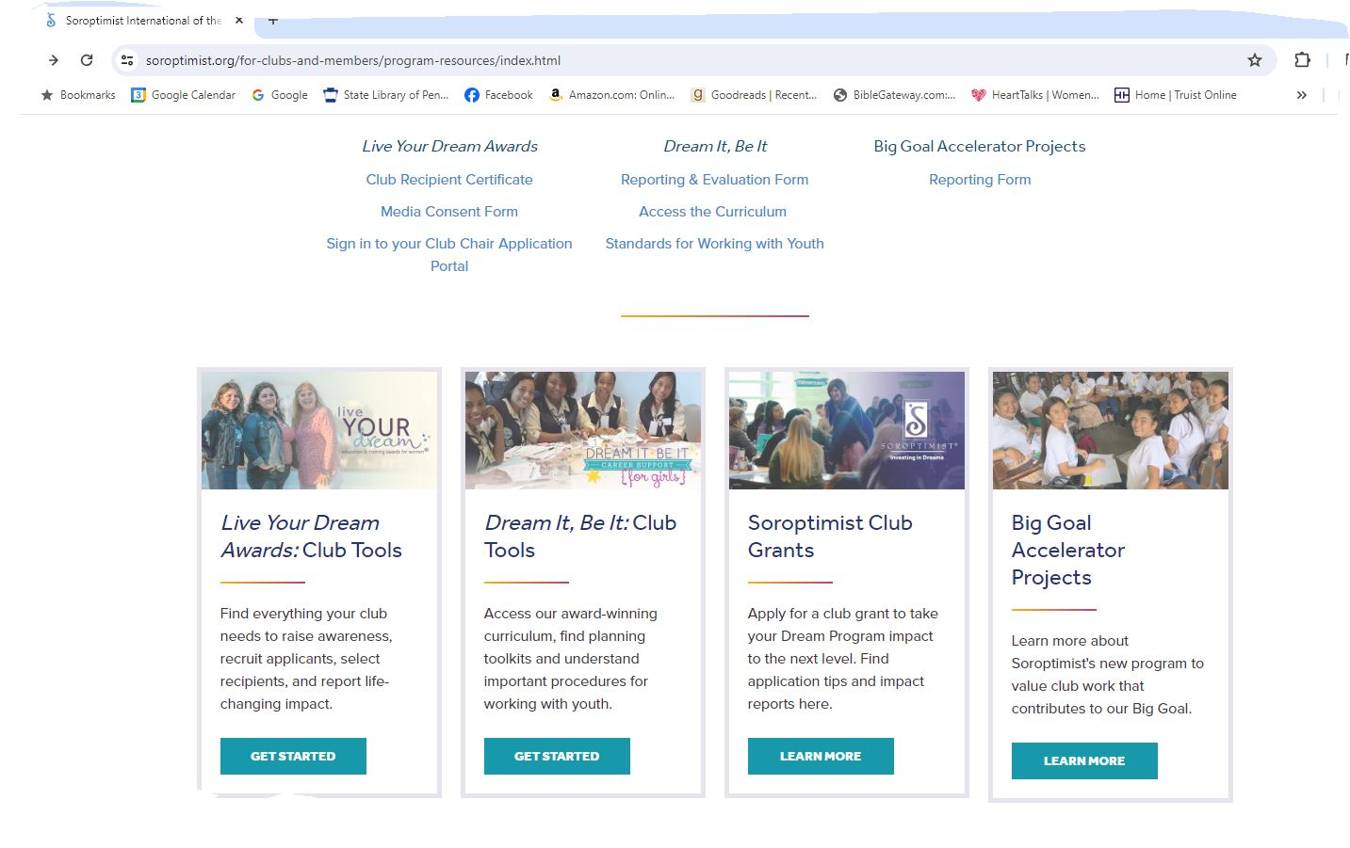
https://www.soroptimist.org/for-clubs-and-members/program-resources/index.html

Slide 4

Live Your Dream
Applications are online beginning August 1 each year and close on November 15
A club member must log into the portal to retrieve the applications and complete the reporting process online
Promoting the applications
Awards, reporting and Media
Questions?

Slide 5

Dream It Be It
Guidelines for Working with Teens
Recruiting participants
Curriculum
Reporting

Slide 6

Big Goal Accelerator Projects
Is the Project eligible?
Could you tweak an existing project?
Reporting
Questions? Workshop tomorrow afternoon will discuss this in further detail

Slide 7
Thank you
Alice Lubrecht
alicelubrecht@gmail.com

