Slide 1

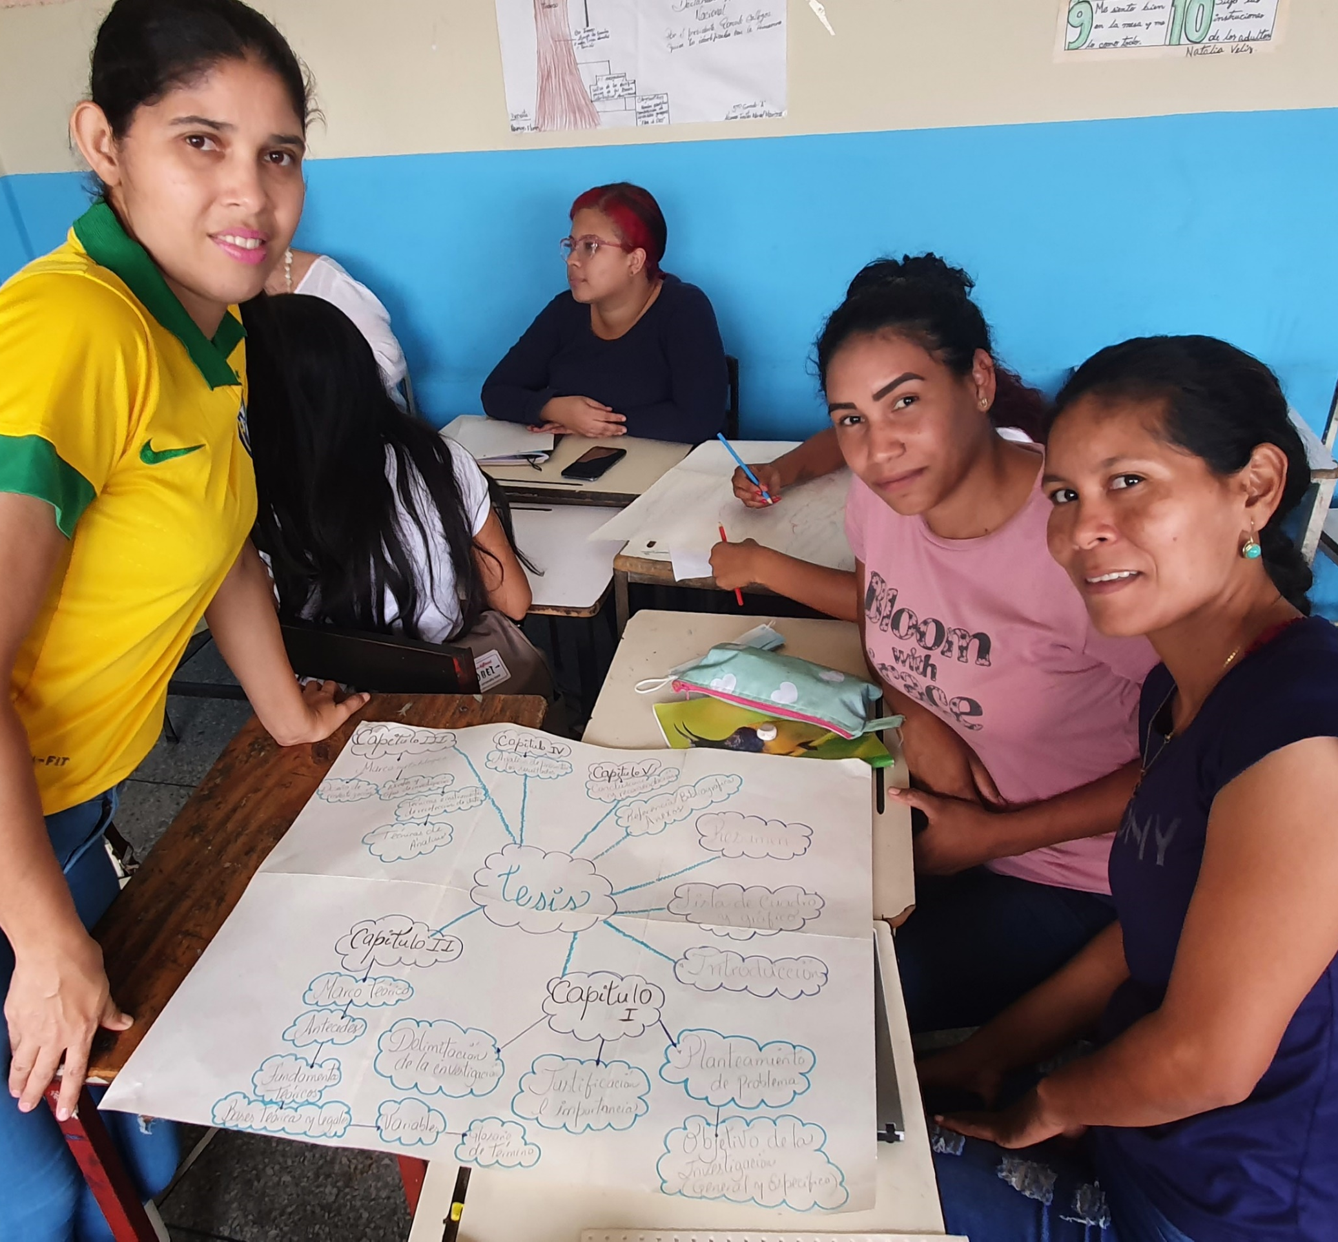

Big Goal
Accelerator
Project
2024 SIA REGION CONFERENCE
Deep Dive
Alice Lubrecht, NAR Program Chair
Notes:
Big Goal Accelerator Projects Deep Dive
Hello everyone, I’m (NAME AND TITLE) and today I’m excited to share the program workshop, the Big Goal Accelerator Projects Deep Dive!

Slide 2
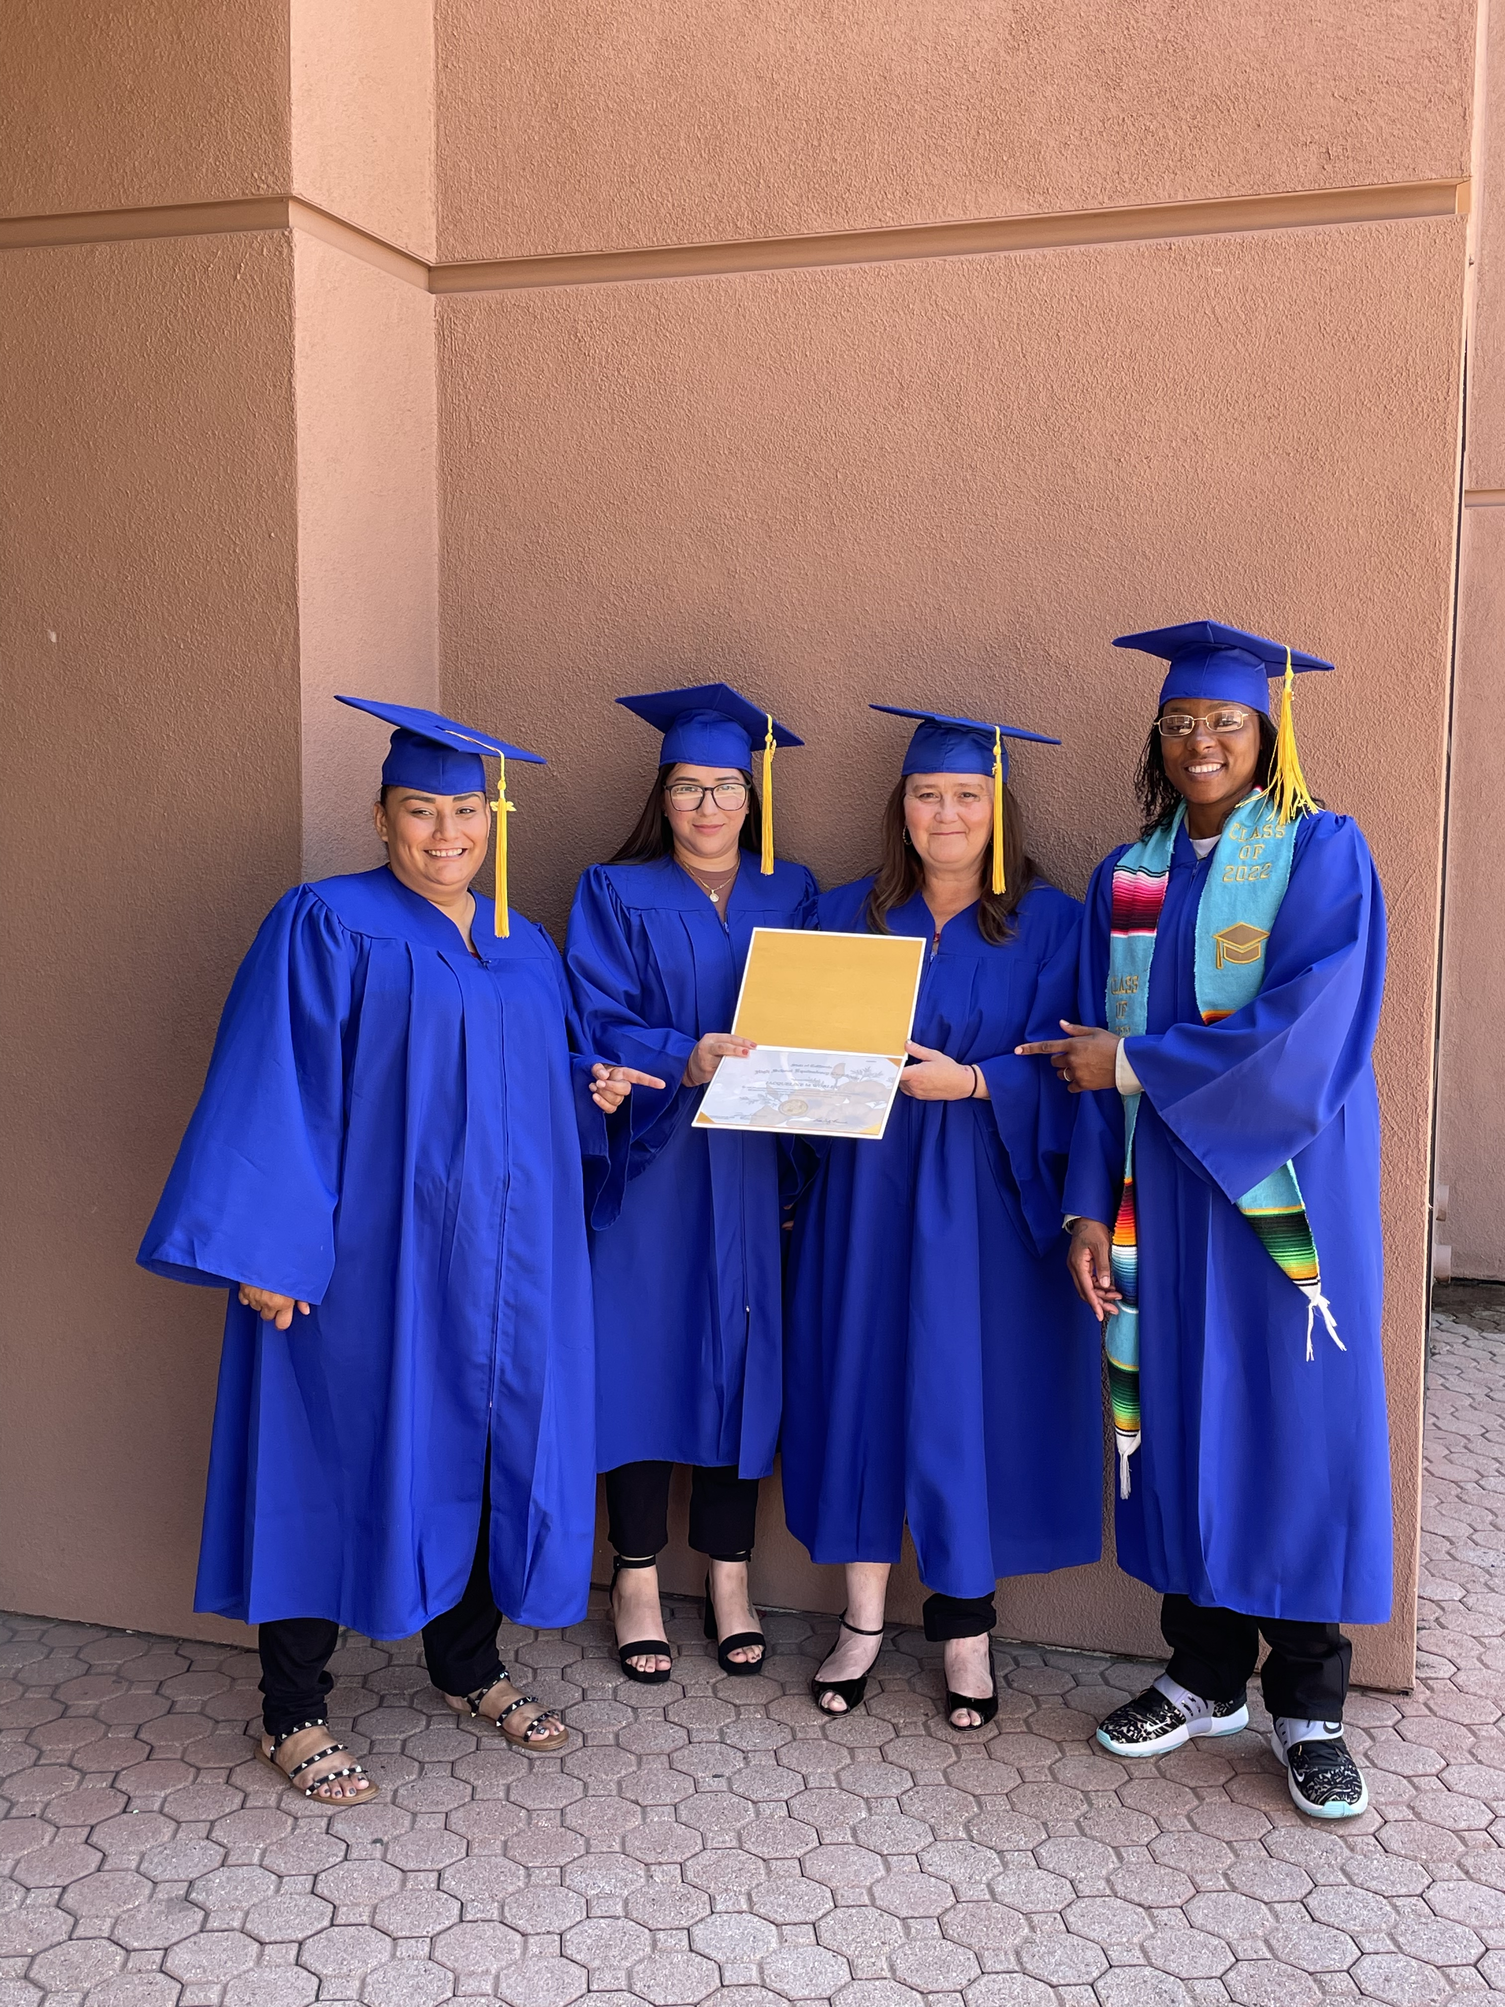


What is our BIG GOAL?
SI/Norwalk Sante Fe Springs
x 500,000
empowered to live their dreams
2024 SIA NAR SPRING CONFERENCE
Notes:
Now for starters, what is our Big Goal? (ask for someone from the audience to tell you! And affirm/correct/add to their answer as needed)
Our Big Goal is to invest in the dreams of half a million women and girls through access to education by 2031. It’s important to understand the Big Goal, because that’s what drives our Big Goal Accelerator Projects.

Slide 3


What do we mean by EDUCATION?
Increase access to FORMAL EDUCATION
EDUCATION-AL is not the same as FORMAL EDUCATION
2024 SIA NAR SPRING CONFERENCE
Notes:
What do we mean by education? We mean increasing their ability to access FORMAL education. This means training that results in a credential. It can also mean providing something that improves their skills or circumstances such that they are more able to access formal education or economic empowerment.
Some clubs may offer things to the community that are focused on awareness raising, or trainings that are educational, like sharing information about healthy relationships, women’s health, or trafficking. This is not the same thing as access to formal education! It may be helpful, but it is not focused on education or economic empowerment.

Slide 4

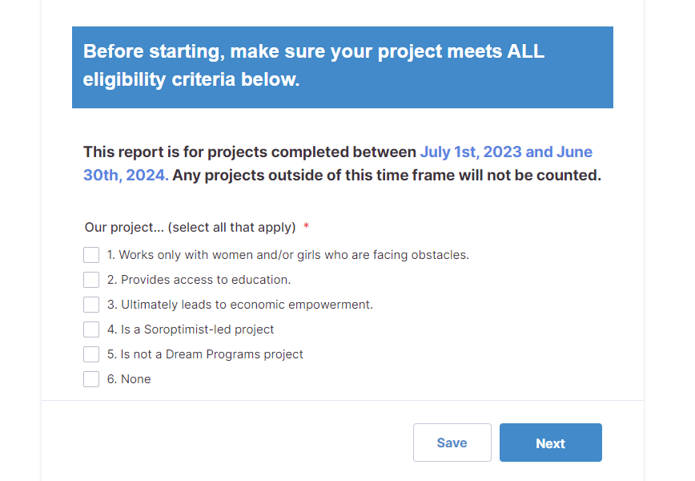
What is eligible?
Work with women/girls facing obstacles
Increase/provide access to formal education
Be Soroptimist-led
NOT a Dream Program
Reported through the official reporting link
Projects must meet all 5 criteria
2024 SIA NAR SPRING CONFERENCE
Notes:
To be eligible and contribute to the Big Goal as an Accelerator Project, club work must meet all the following criteria:
Work only with women and/or girls who are facing obstacles
Increase or provide access to formal education with the goal to ultimately lead to economic empowerment
Be a Soroptimist-led project
NOT be the Dream Programs or the same women and girls reached through the Dream Programs. Remember that we are counting individual women and girls reached for our Big Goal, not service projects conducted.
Be reported to SIA through the official reporting link—you can’t receive credit for your project if no one knows about it!

Slide 5
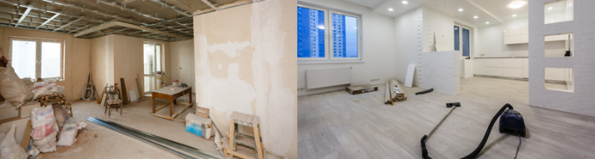
What is NOT eligible?
Here are some examples:
Awareness raising projects
Beautification of space
General social empowerment
Projects not serving women/girls facing obstacles
Donations to other organizations
  Not Soroptimist-led
2024 SIA NAR SPRING CONFERENCE
Notes:
What kinds of projects are not eligible?
Projects that focus on raising awareness about any topic
Beautification or refurbishment of a space
General social empowerment
Projects that serve anyone other than women and/or girls facing obstacles
Donations to another organization
Any projects that are not Soroptimist-led

Slide 6
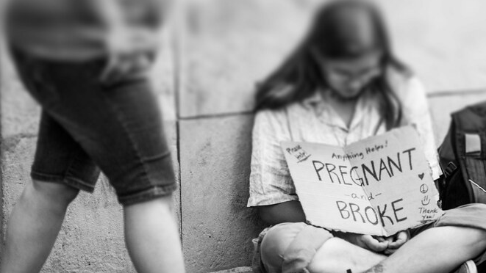
Obstacles
Poverty
Violence
Racism
Teen pregnancy & parenting
Foster care
Trafficking
Single parenting
Substance use disorder
2024 SIA NAR SPRING CONFERENCE
Notes:
What do we mean by “obstacles?”
These are some examples of the obstacles that can make accessing education more difficult for a woman or girl, in addition to her gender:
• Poverty
• Violence
• Racism
• Teen pregnancy and parenting
• Being a foster care youth
• Trafficking
• Single parenting
• Substance use disorder
And others. If you’re not sure if something is an obstacle, reach out to SIA to discuss.

Slide 7
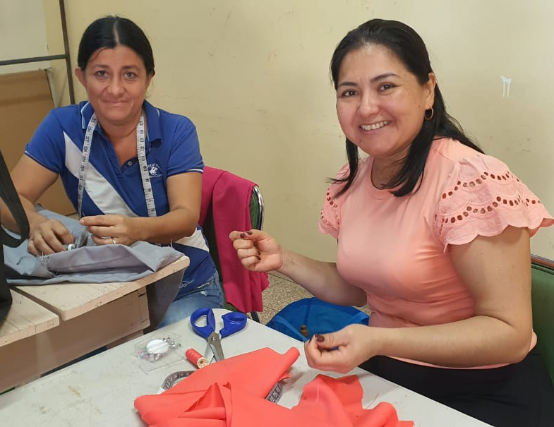

Eligible Project Categories
Scholarship/education awards
Providing necessary items
Classes focused on job/skills/computer training, career mentorship
SI/David: Basic Cutting and Sewing Course
2024 SIA NAR SPRING CONFERENCE
Notes:
What are the project categories that are eligible?
• Scholarships or education awards
• Providing necessary items for education like computers, internet, transportation; paying fees for college-preparation exams, college applications, entrance exams, or professional licensure
• Classes that are focused on job training, skills training, applying for financial aid/college, computer training, career mentorship

Slide 8
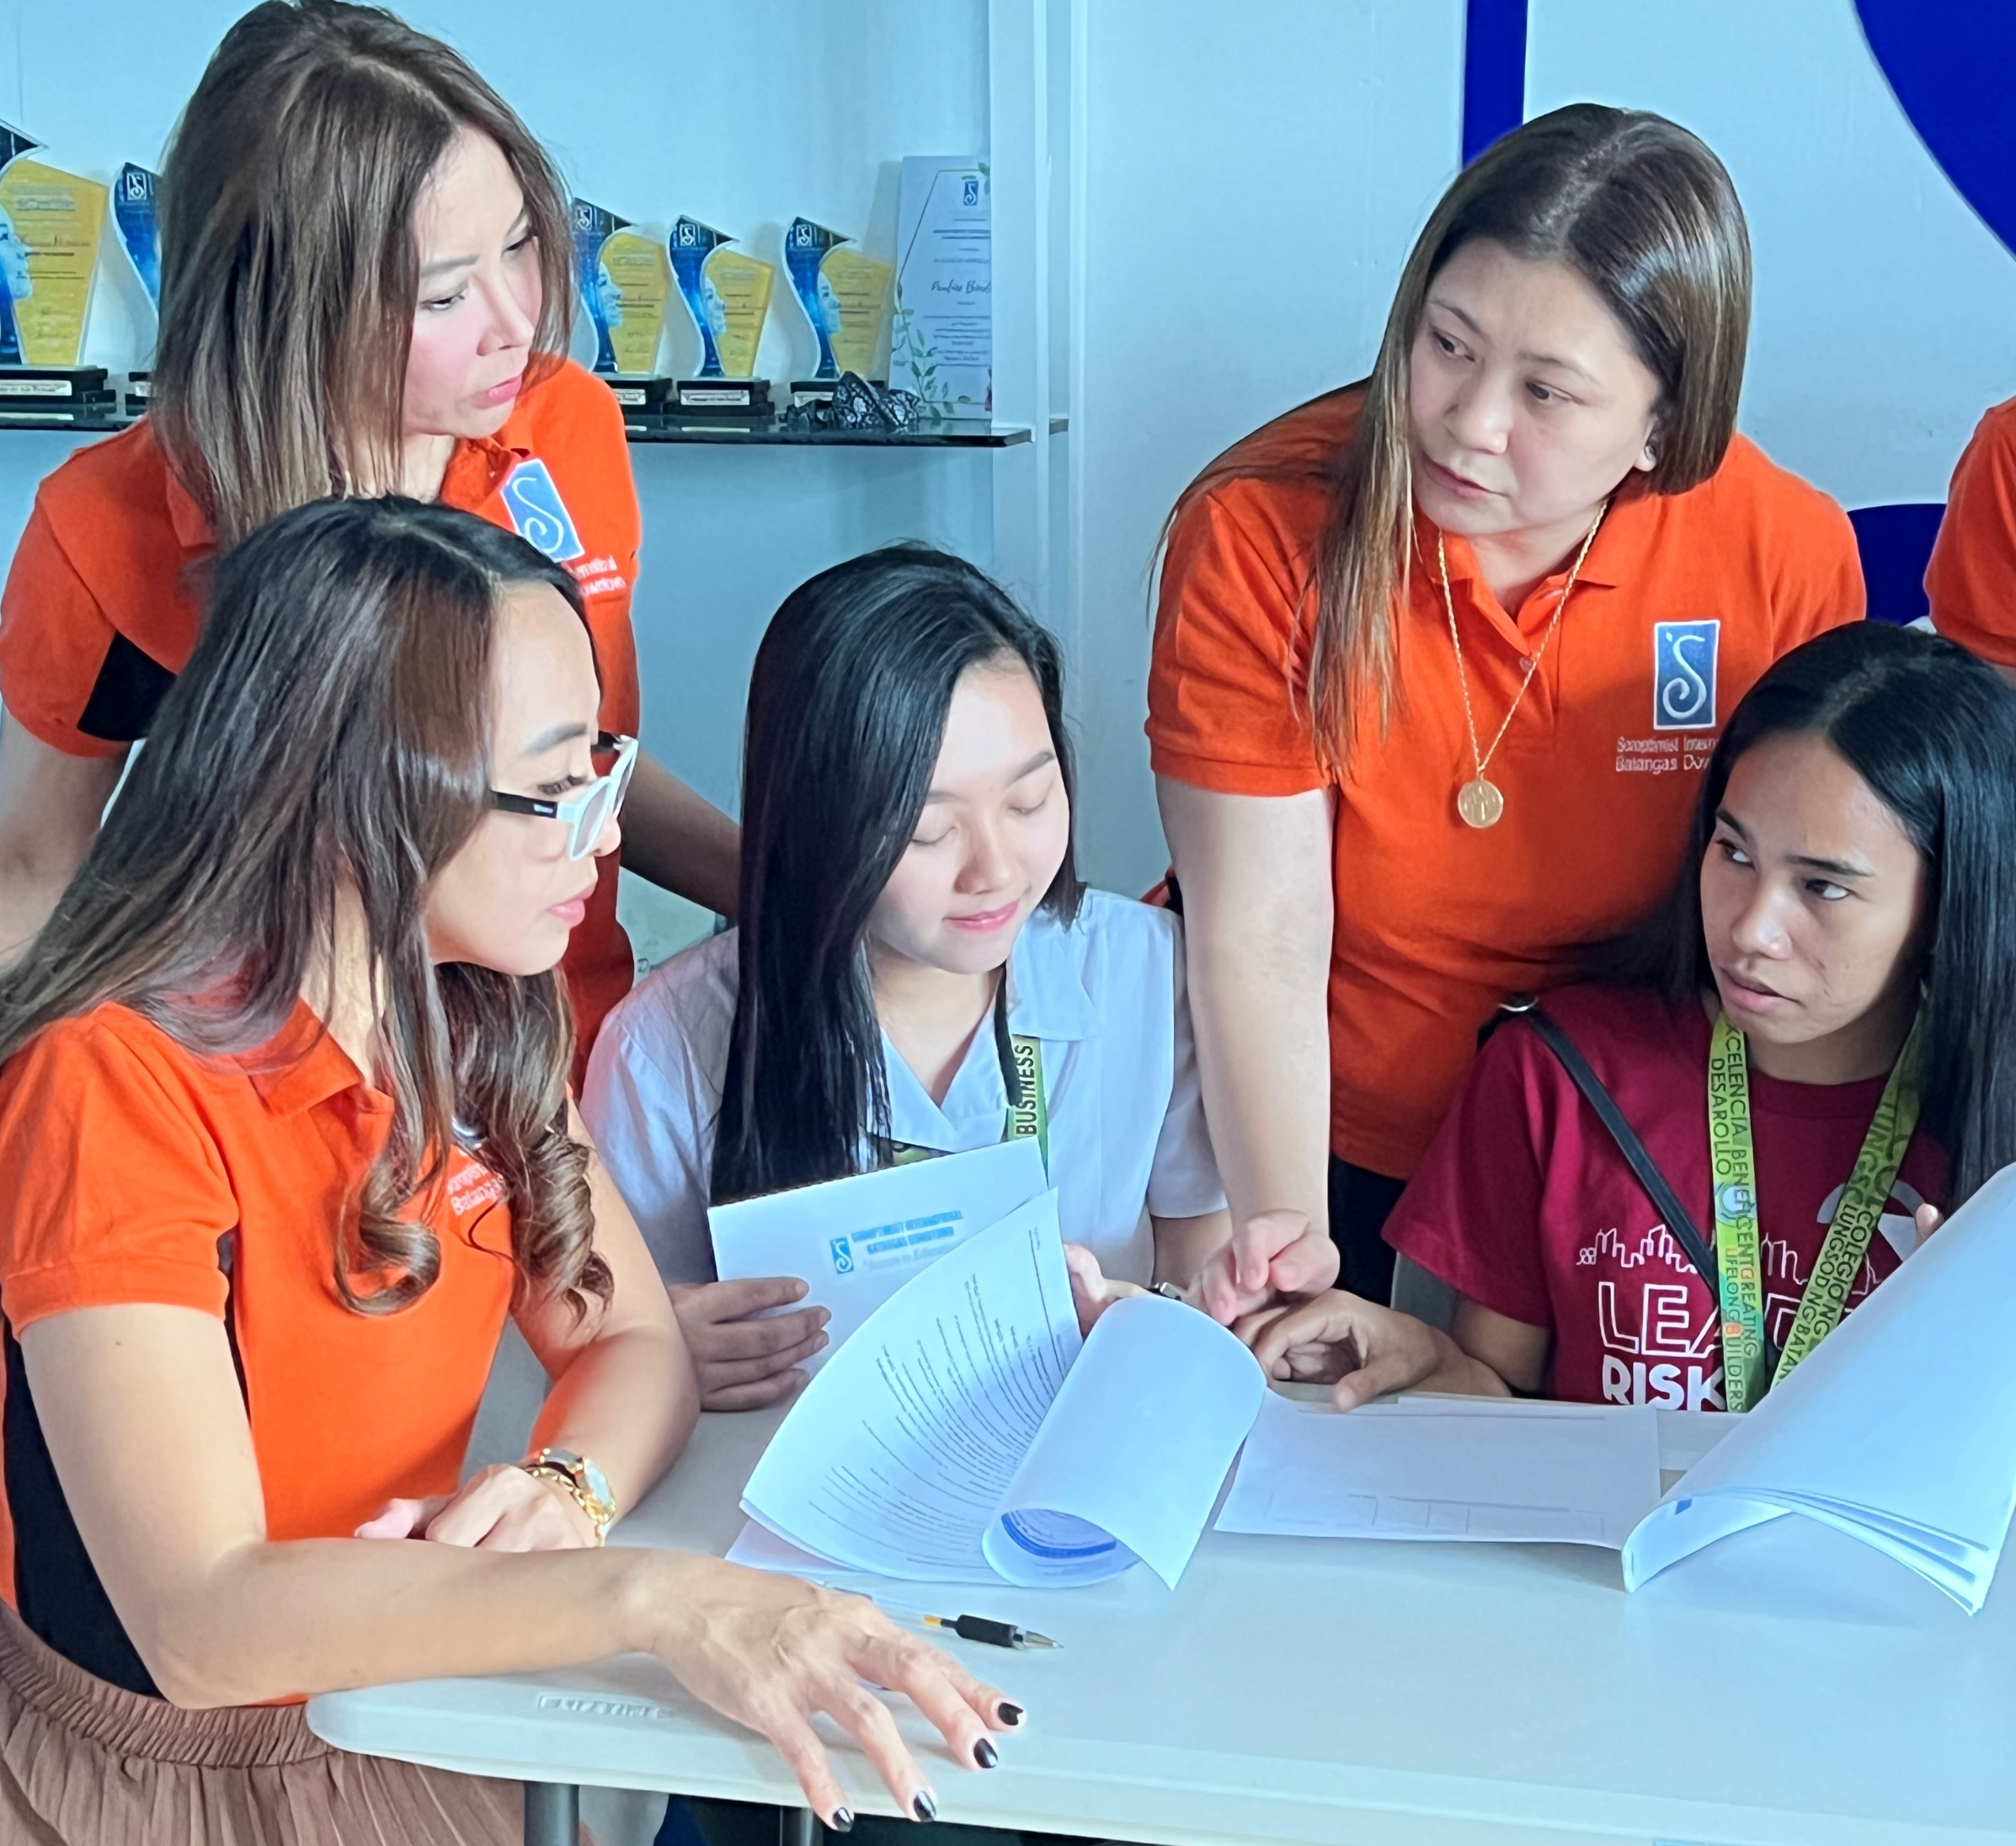
SI/Batangas Downtown: SIBDream
Do clubs HAVE to do a Big Goal Accelerator Project?
2024 SIA NAR SPRING CONFERENCE
Notes:
Do clubs HAVE to do a Big Goal Accelerator Project?
No, they do not. If your club is having a hard time because of membership or fundraising difficulties or you are just at maximum capacity doing the Dream Programs, we do not want you to burn out! But, if your club has projects that are already eligible, or projects that can easily be changed so that they are eligible, or you’re ready to start a new project, we certainly want you to do that so we can reach our Big Goal!

Slide 9
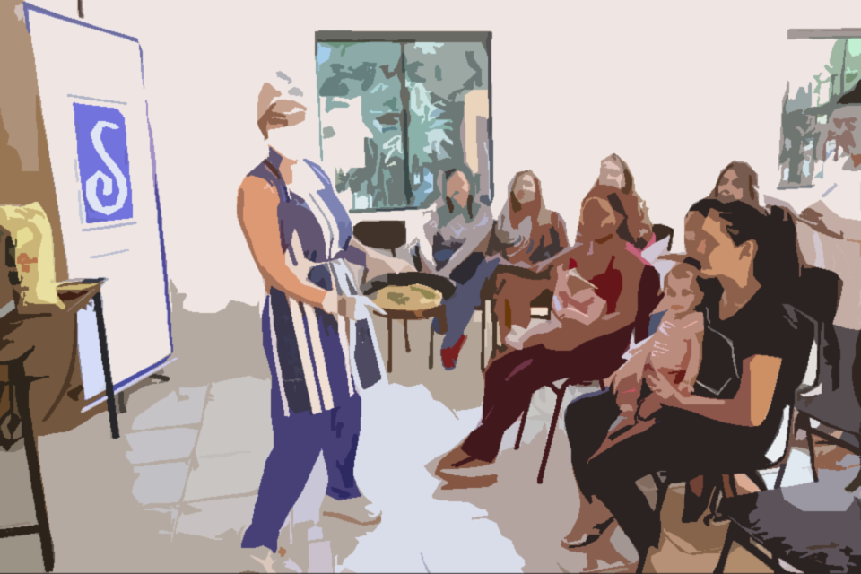
Population
Focus
People
Right
2024 SIA NAR SPRING CONFERENCE
Notes:
To summarize, to be eligible a project must have the following components in place:
Must be the right population (women and girls facing obstacles who are NOT already served by the Dream Programs)
Must be the right focus (increasing access to formal education)
Must be completed by the right people (Soroptimist-driven, hands-on projects)

Slide 10

NOT Eligible
Donation to charity
2024 SIA NAR SPRING CONFERENCE

Slide 11
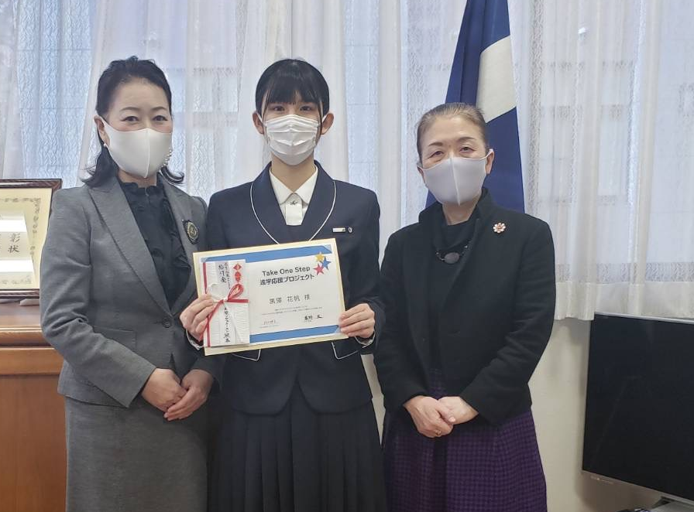
SI/Kumamoto: Supporting Girls’ Continued Education
Eligible
Scholarship directly to girl
2024 SIA NAR SPRING CONFERENCE
Notes:
To make that project eligible, you would want to make sure it’s a scholarship going directly to the girl (not a donation to a charity of her choice) and make sure you add some consideration of obstacles faced to the application. This could include financial need, or consideration of life circumstances like if she’s living in foster care, to ensure that your club is giving a scholarship to a girl who actually needs it. This project already meets the requirement of being a Soroptimist-led project, so no need to change it up there!

Slide 12

NOT Eligible
New Laptop to
Live Your Dream Awards recipient
2024 SIA NAR SPRING CONFERENCE
Notes:
Now let’s look at this example: a club gives a past Live Your Dream Award recipient a new laptop when her old laptop breaks, so that she can continue to get her coursework done. What would the club need to change here to be Big Goal eligible?
(take audience suggestions)

Slide 13
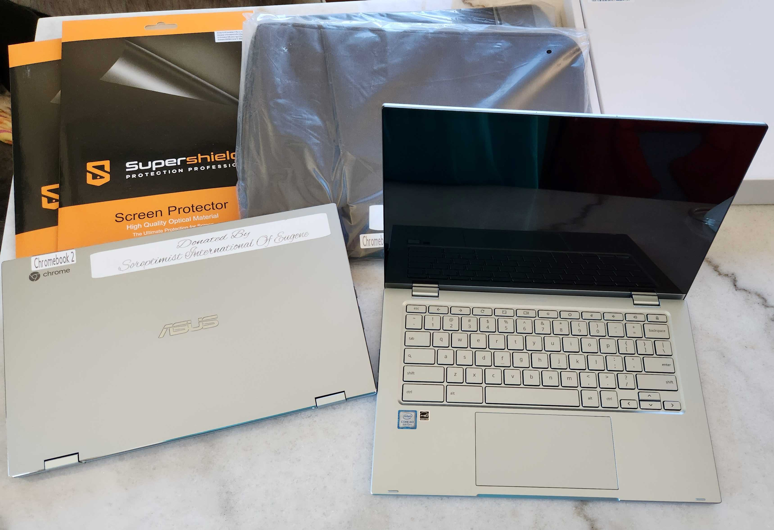
SI/Eugene: Lending Library Willamette Family
Eligible
Provide a laptop to a women who has not received a
Live Your Dream Award
2024 SIA NAR SPRING CONFERENCE
Notes:
If the club is giving the laptop to a past Live Your Dream Awardee, they should be reporting that with their Live Your Dream online club report, not as a Big Goal Accelerator Project. Why? Because that woman was already counted towards the Big Goal. We want to reach half a million individual women and girls, so we want to avoid double counting anyone to the best of your ability. If the club provided a low-income woman enrolled in school with a laptop who was NOT a Live Your Dream Awardee, that would be perfectly eligible as a Big Goal Accelerator Project.

Slide 14
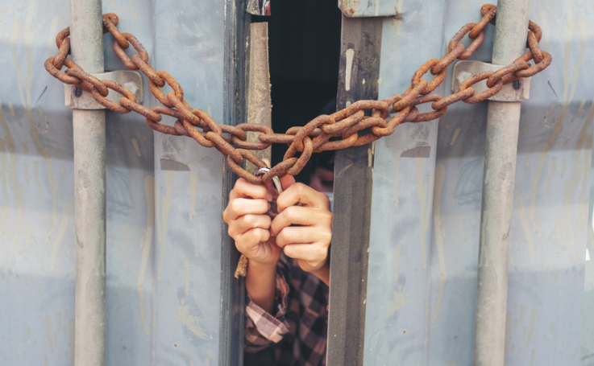
NOT Eligible
Workshops on signs of human trafficking
2024 SIA NAR SPRING CONFERENCE
Notes:
Let’s look at another project. Let’s say your club has been doing workshops with local businesses about how to spot the signs of human trafficking and has been sharing flyers about it in grocery stores, schools, and other places. What would need to change for this to be eligible?
(take audience suggestions)

Slide 15

Eligible
Scholarship for a woman who has experienced trafficking
2024 SIA NAR SPRING CONFERENCE
Notes:
This is one of the awareness raising projects that is not eligible, and it doesn’t focus on access to education. But many clubs feel that this is an important issue. Your club could choose to ask one of those businesses to financially sponsor a scholarship for a woman who has experienced trafficking. That would then be a Soroptimist-led project that increases access to education for women who have obstacles to their success.

Slide 16
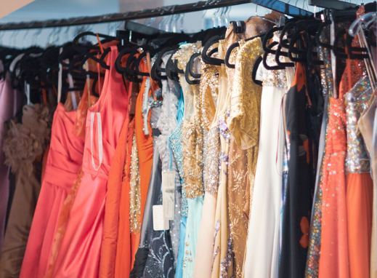
NOT Eligible
Prom dress giveaway
2024 SIA NAR SPRING CONFERENCE
Notes:
Here’s another example: a club hosts a prom dress giveaway for low-income girls attending a local high school. What’s missing here?
(take audience suggestions)

Slide 17
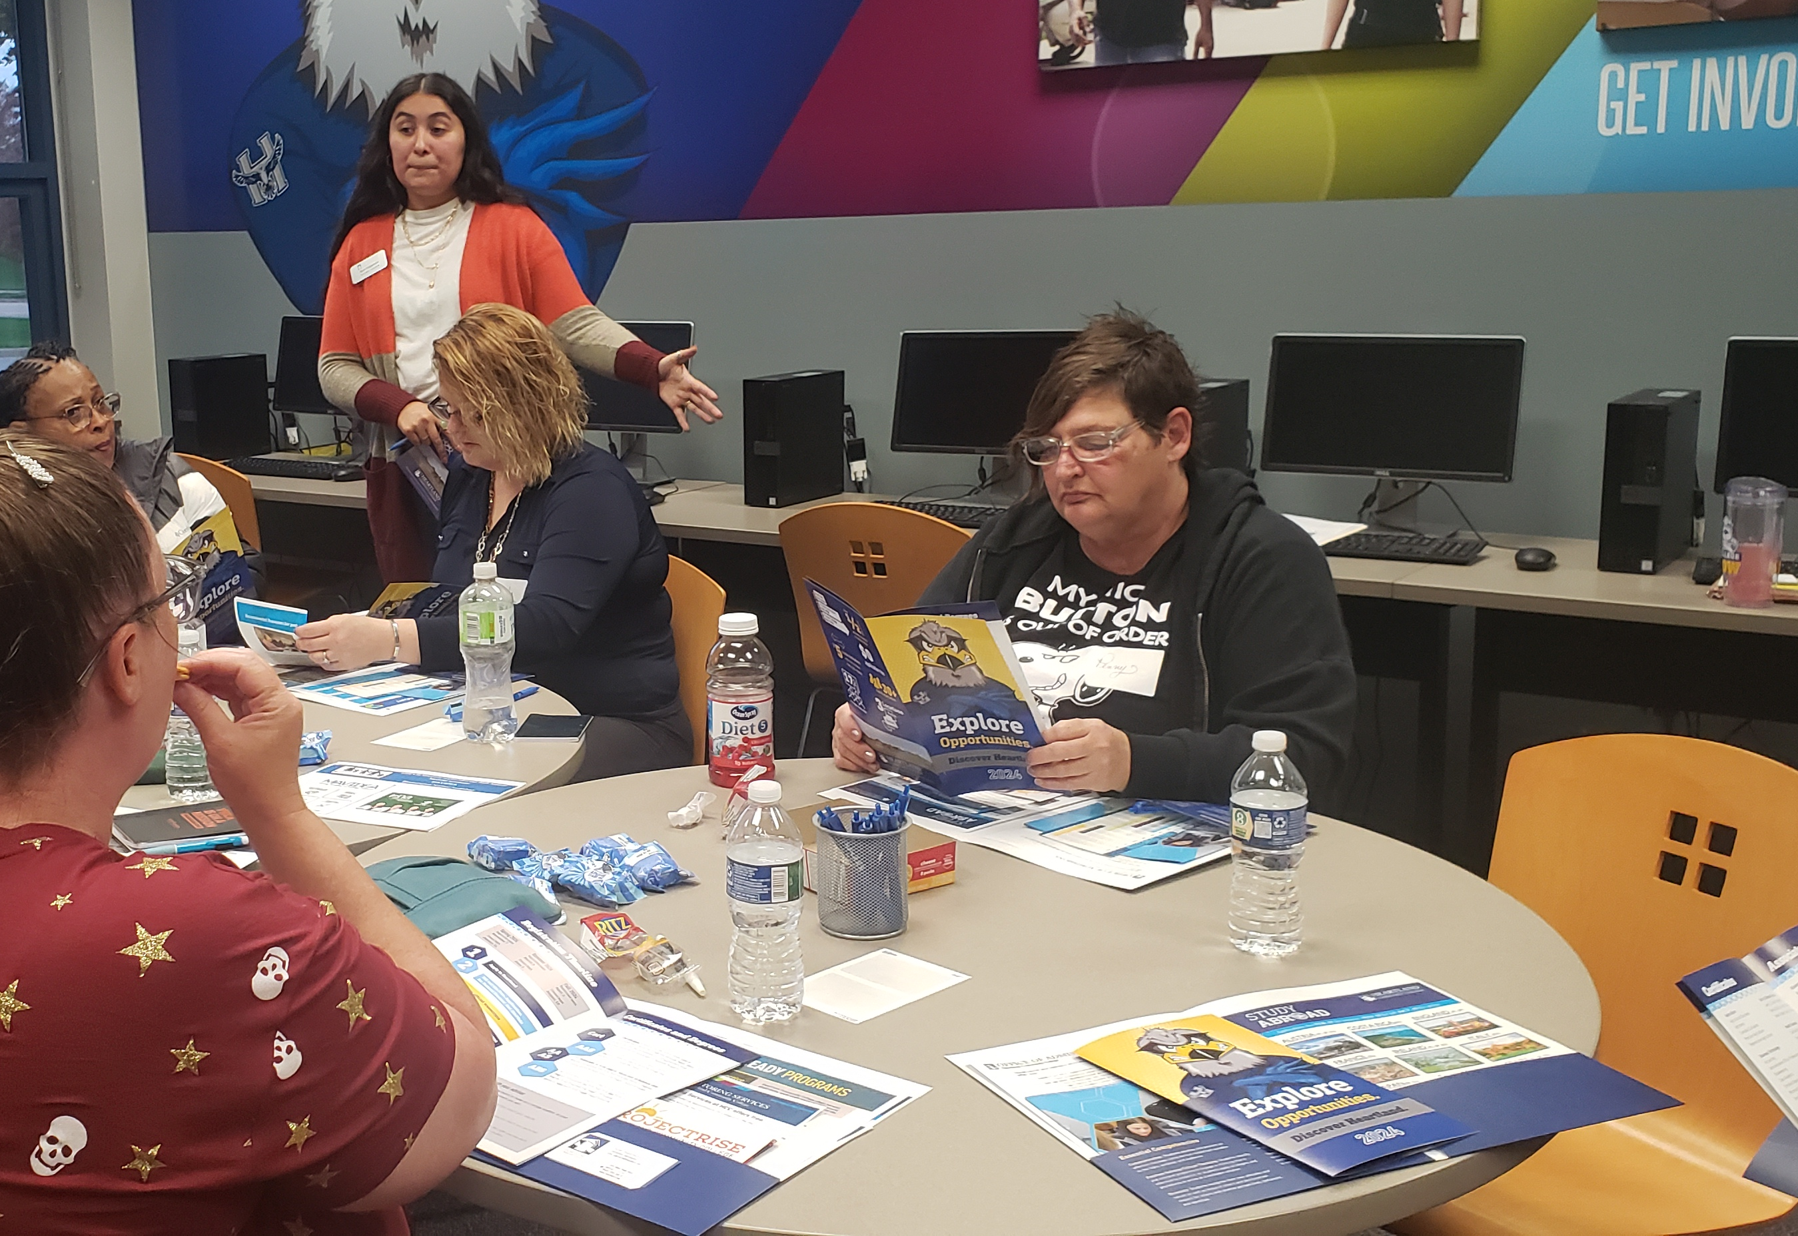
SI/Bloomington Normal: Dream It, Reach It for Reentry Women
Eligible
Class on job/college interviews and how to dress
2024 SIA NAR SPRING CONFERENCE
Notes:
It’s not focused on access to education, but it is Soroptimist-led and focused on girls with obstacles to their success! Your club could instead provide classes to these girls focused on job or college interview skills and how to dress for these interviews. Your club could even then provide some clothing items to these girls to make sure they can apply what they’ve learned.

Slide 18

NOT Eligible
Donation to
local nonprofit that rehabilitates marine life
2024 SIA NAR SPRING CONFERENCE
Notes:
Here’s another example: a club donates money to a local nonprofit that rehabilitates sick or injured marine life, like sea turtles and seals. What’s missing here?
(take audience suggestions)

Slide 19
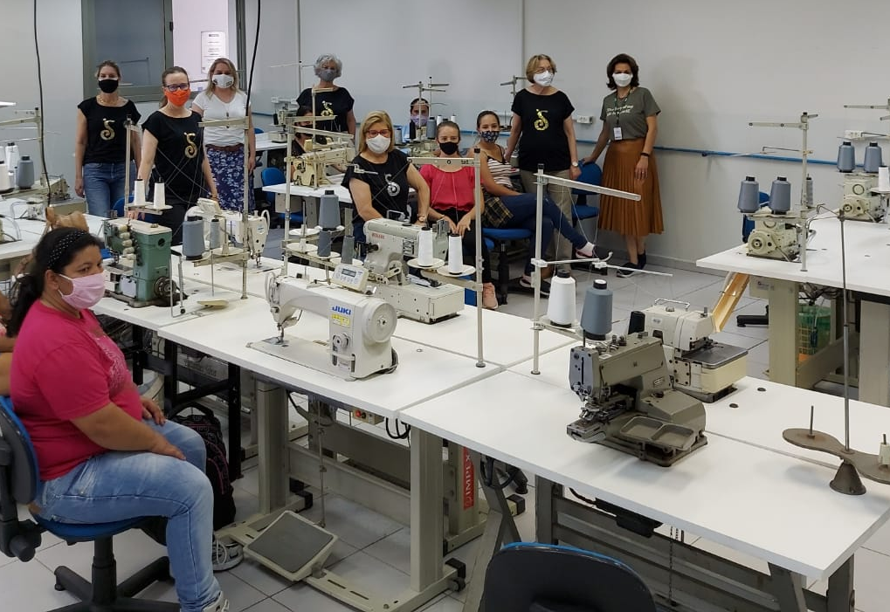
SI/Rio Negro: Economic Activities and Training
Focus on another project!
2024 SIA NAR SPRING CONFERENCE
Notes:
It’s not focused on women and girls with obstacles, access to education, or Soroptimist-led. This one is so far from the focus of our Big Goal, the club should likely either stop doing the project or reduce their support for it so they can focus more on eligible projects.
(If time permits and you feel comfortable, take audience suggestions for other projects and have members discuss how to make them eligible if they are not already)

Slide 20
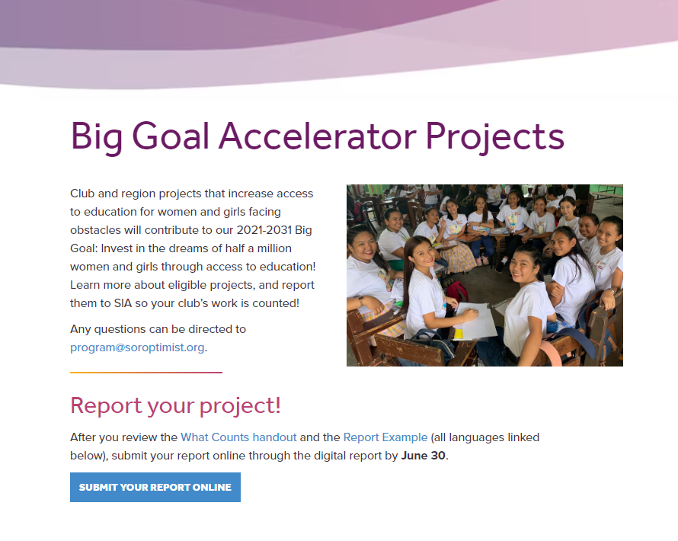



Report your project!
How do we report?
Online Reporting Form
Deadline: June 30
2024 SIA NAR SPRING CONFERENCE
Notes:
Now the final step here—you must report your project to SIA to have it counted!
How do we report?
Clubs must report all of their projects for that club year through the online reporting form by the annual deadline of June 30th. SIA staff will review the reports on an ongoing basis for eligibility and be in touch with clubs as needed with questions.

Slide 21
Did you get a confirmation email?
2024 SIA NAR SPRING CONFERENCE
Notes:
If you submit a report but do not get an automated email with a copy of your report, email SIA immediately because it’s possible something went wrong, and your report was not received! Make sure you get credit for your hard work.

Slide 22


Let’s work together to reach our
BIG GOAL!
2024 SIA NAR SPRING CONFERENCE
Notes:
Remember, it’s only by working together that we can reach our Big Goal! This includes reporting all eligible Big Goal Accelerator Projects and seeing if you can change what you’re currently doing to make it eligible. Change can be hard, but we can handle it—we’re Soroptimists! Thank you.

