Slide 1


Reaching New Heights
2024 SIA REGION CONFERENCE
Official Visitor Speech
PRESENTER NAME, PRESENTER TITLE
Notes:
Greetings Soroptimist friends! It’s such a pleasure to be with you to celebrate our 2024 Region Conference. I can feel your love and enthusiasm for SIA. And I’m so impressed by your impact, continued dedication, and commitment to helping women and girls achieve their dreams.

Slide 2
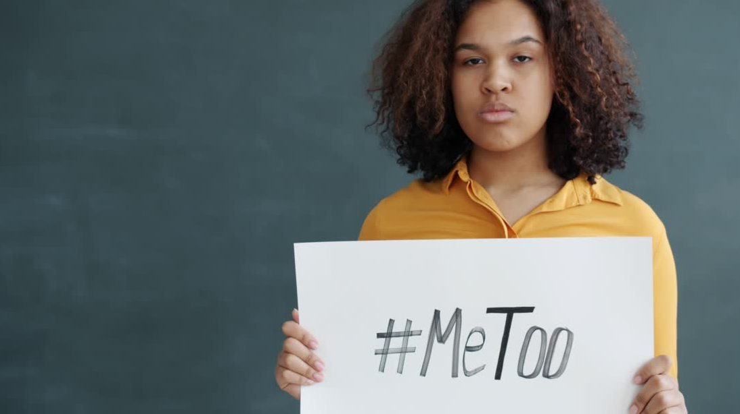

Reaching our Big Goal
More Dream Awards
Increased mentoring for girls
New Big Goal Accelerator projects
More than 59,000 women & girls assisted
2024 SIA REGION CONFERENCE
Notes:
It’s because of that dedication and commitment we are moving even closer to achieving our Big Goal of helping half a million women and girls achieve economic empowerment through access to education by 2031. Together, we’re providing more Dream Awards to women, mentoring more girls through Dream It, Be It, and providing even more opportunities for empowerment through our Big Goal Accelerator projects. In fact, just this past year, we have helped nearly 59,000 women and girls through projects that work towards hitting our Big Goal!

Slide 3
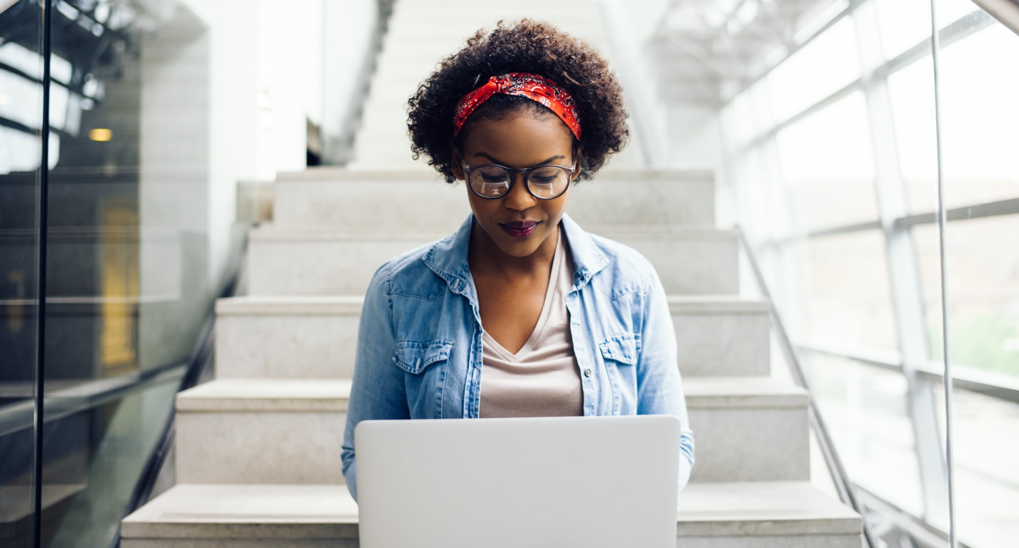


New Technology:
New Database
Member Portal
Updated Website
Notes:
But, that’s not all!
Right now, we’re embarking on a technology transformation that will help revolutionize the way we operate, greatly increasing our brand exposure and organizational growth. New tools include an innovative database to house all of our information with stronger security, a state-of-the-art member portal so that we can communicate with each other like never before! And, finally, we start work on a brand-new Soroptimist website!

Slide 4
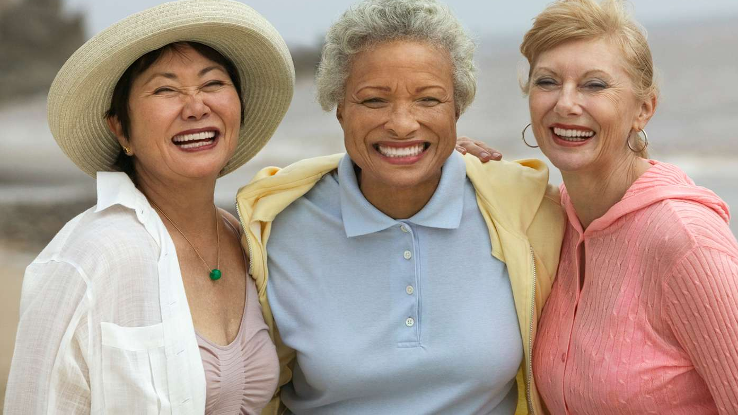
Our greatest asset is
each other.
Notes:
All of this new innovation is exciting! Yet, we mustn't forget. Our greatest resource is each other. Members like you! And members like me. Members who are inspired, engaged, and committed to making a difference. Members who feel empowered when helping others. And most importantly, members who dare to dream!

Slide 5
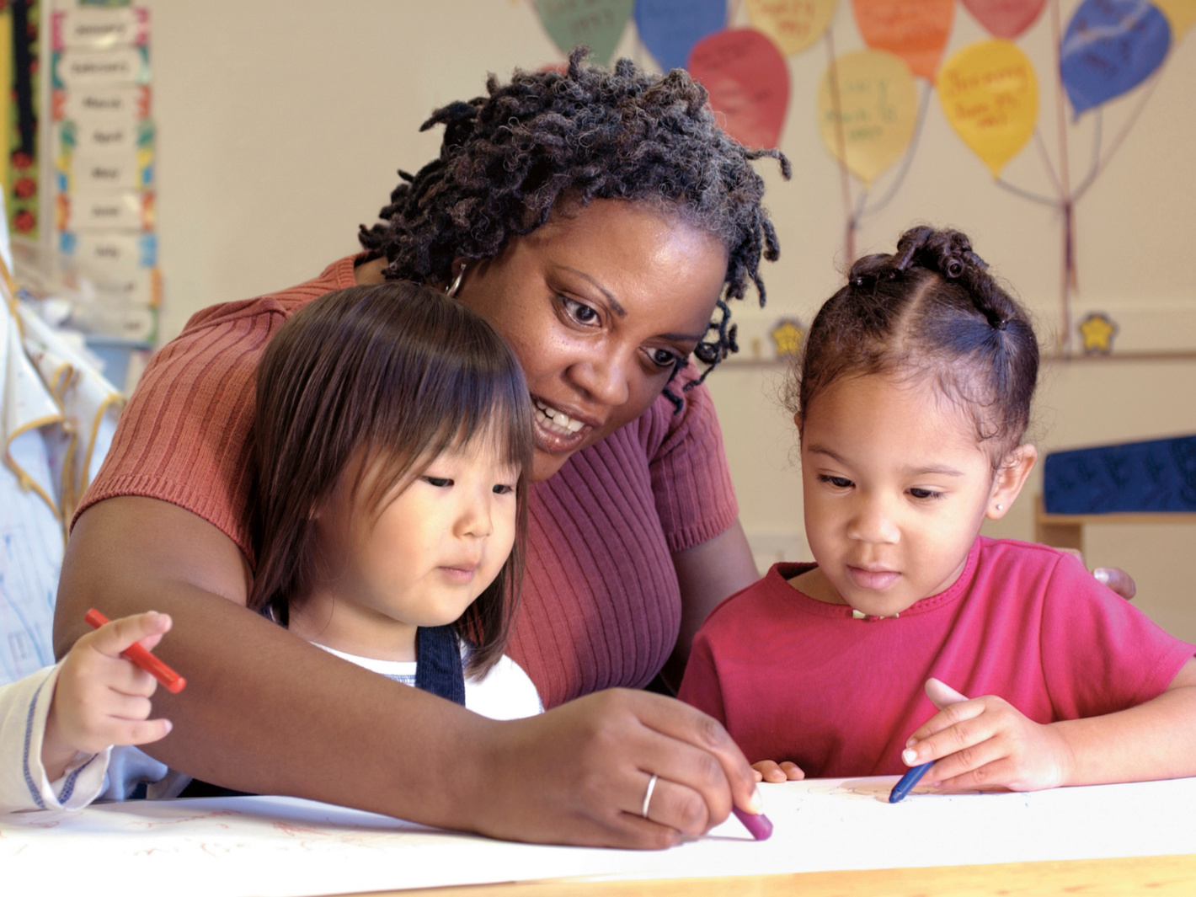
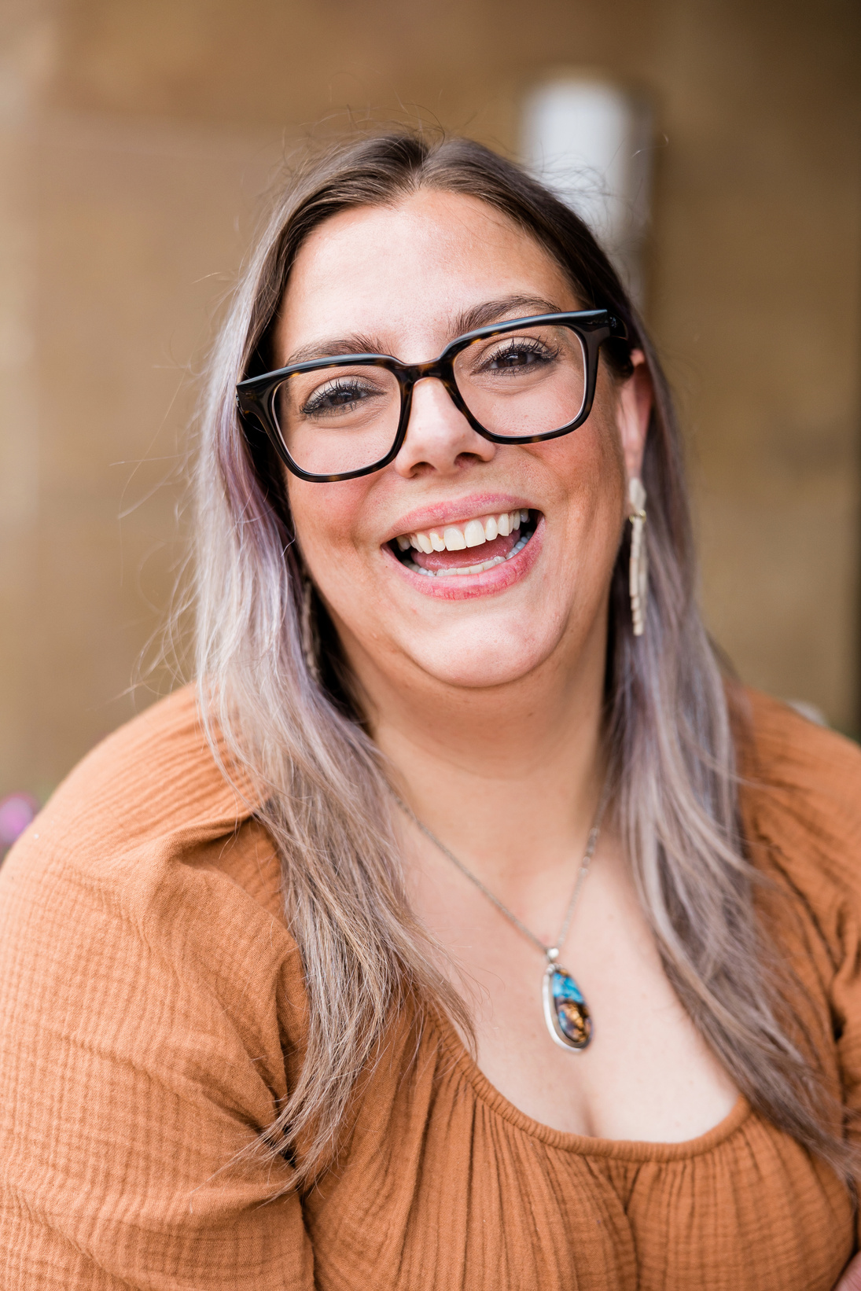

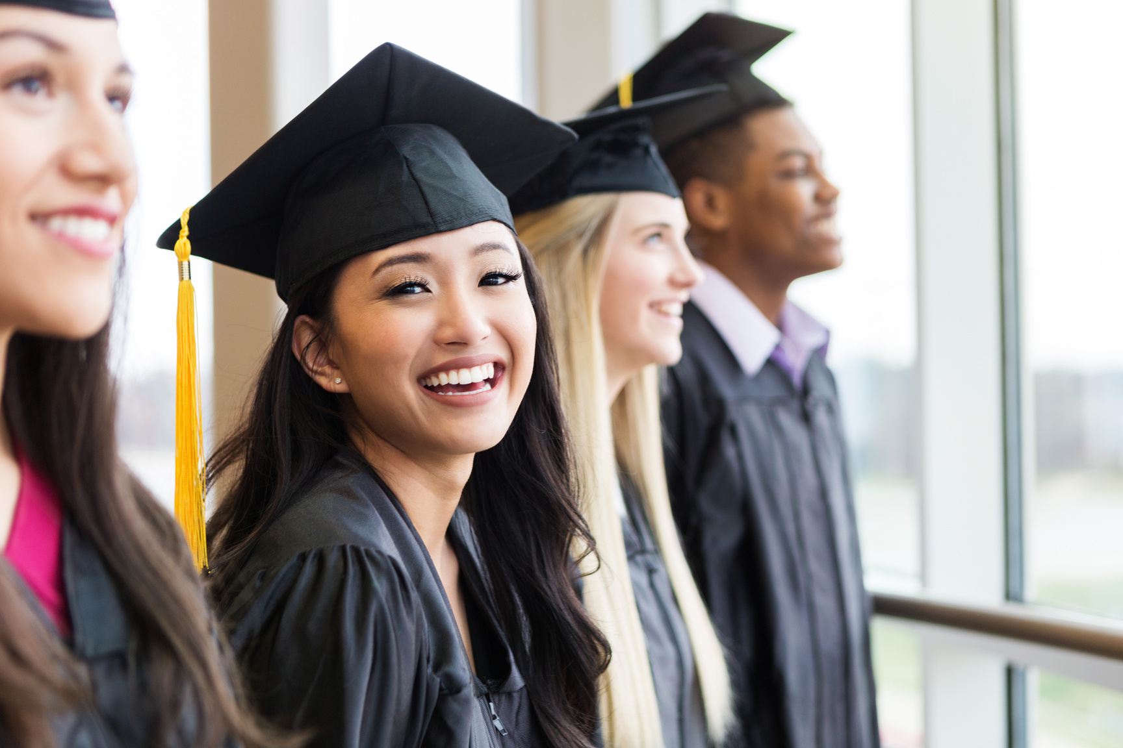
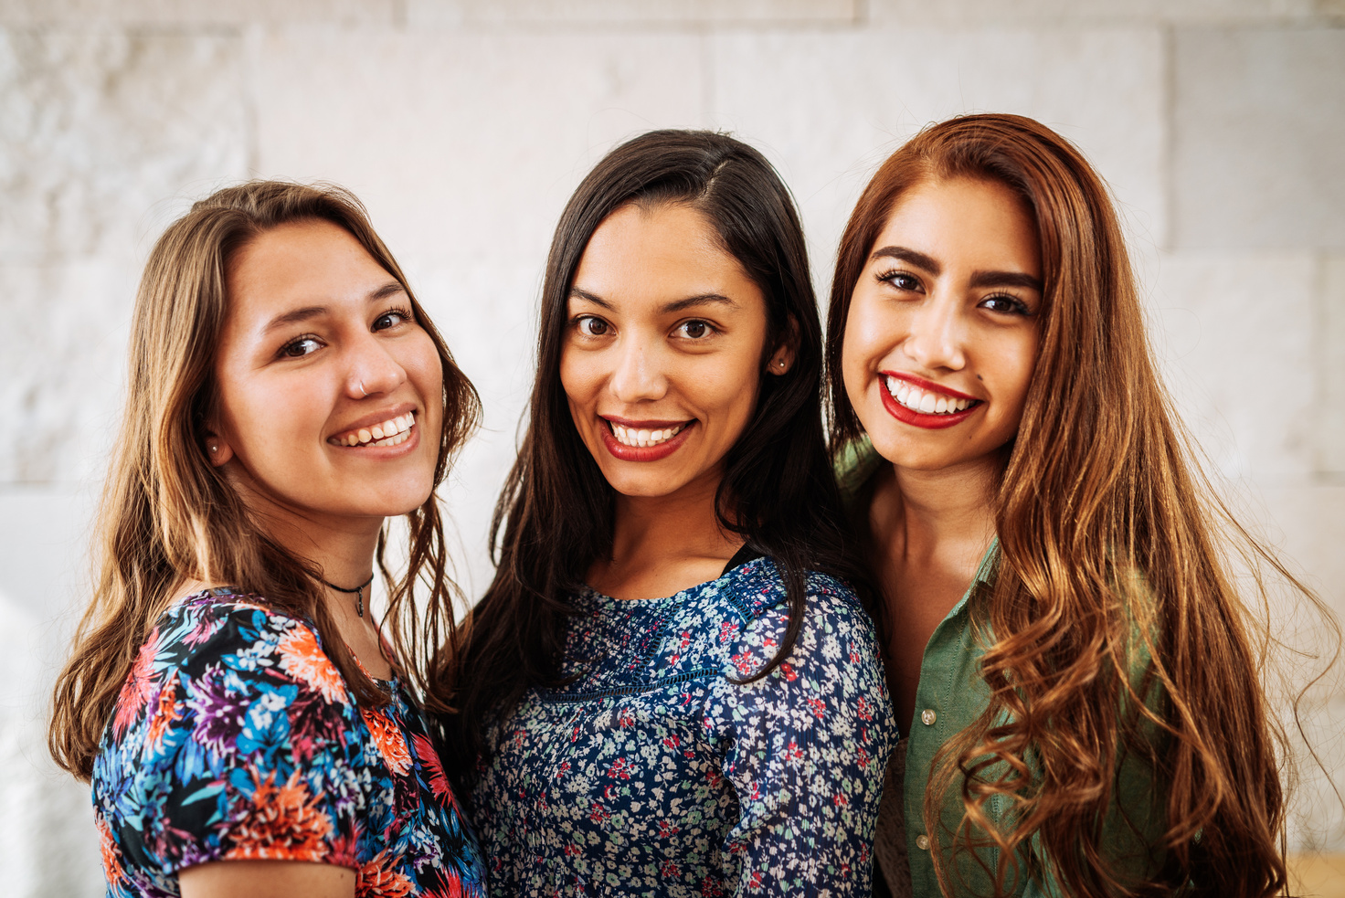
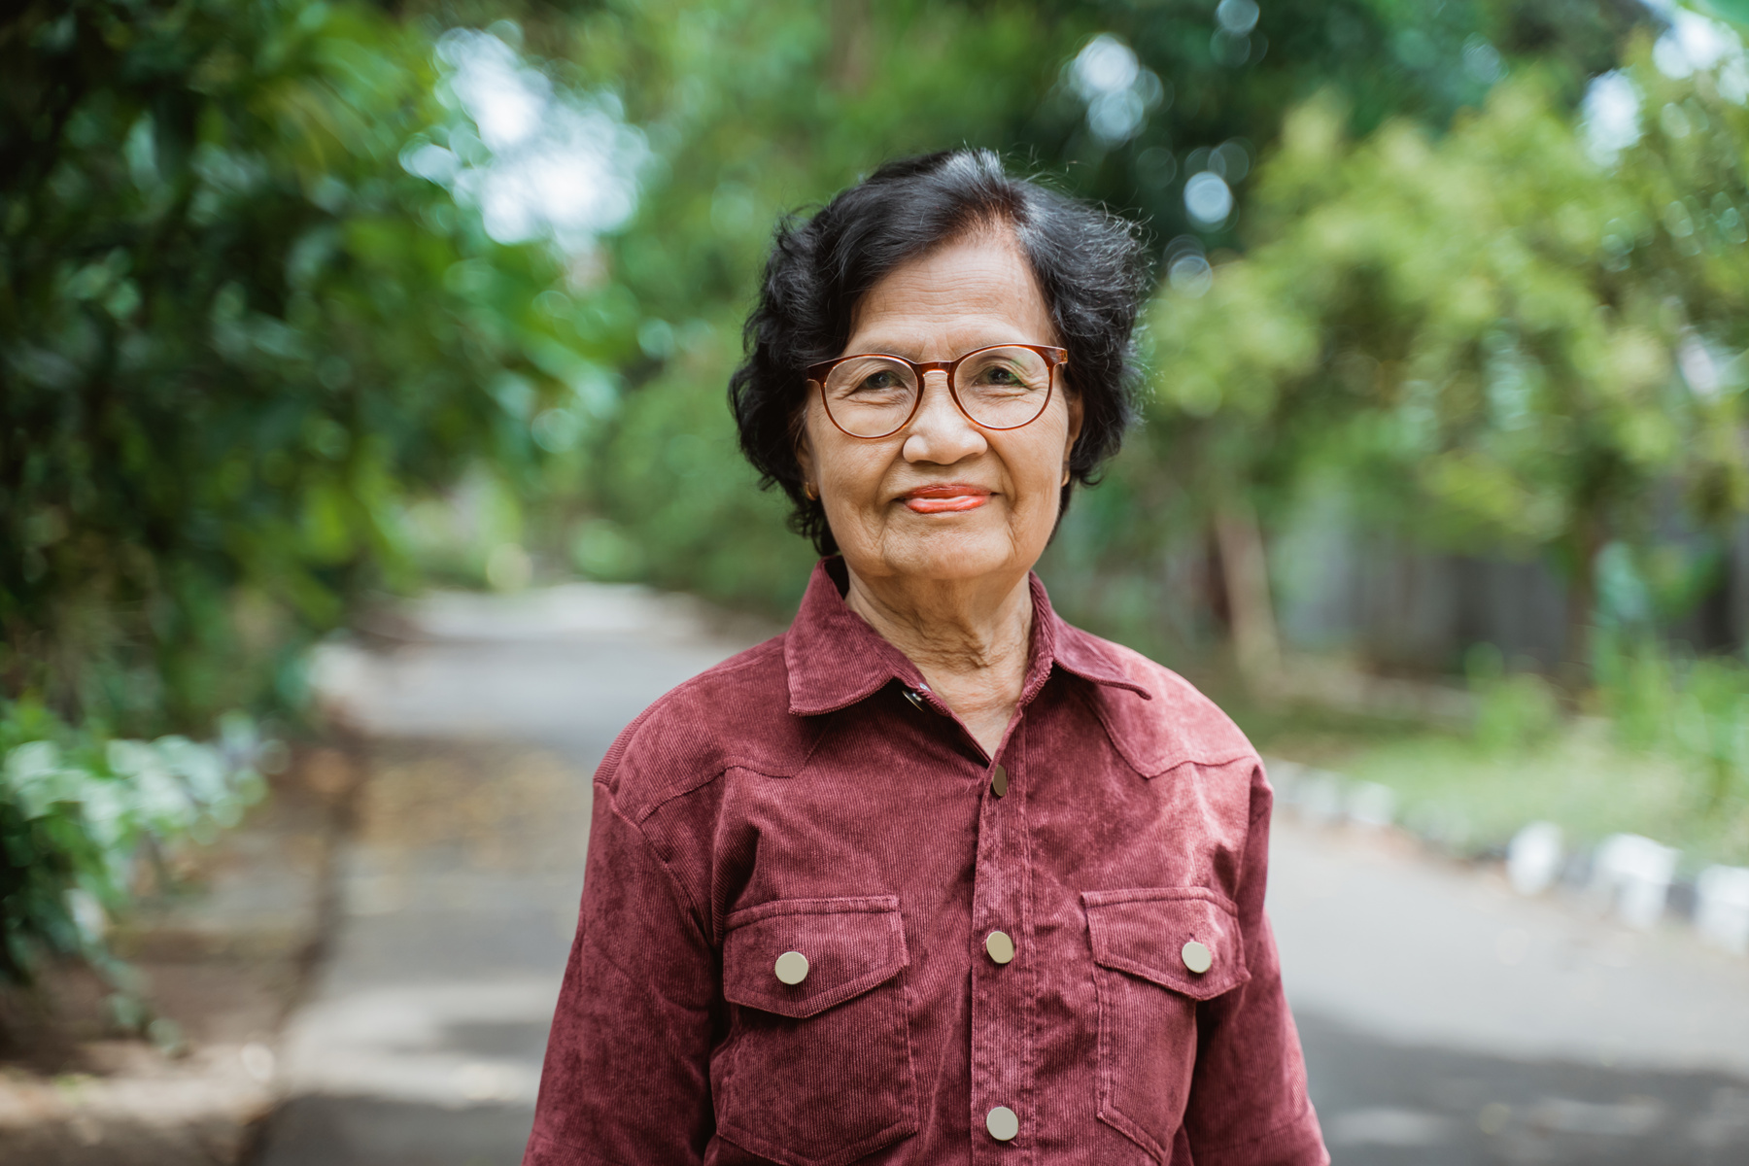
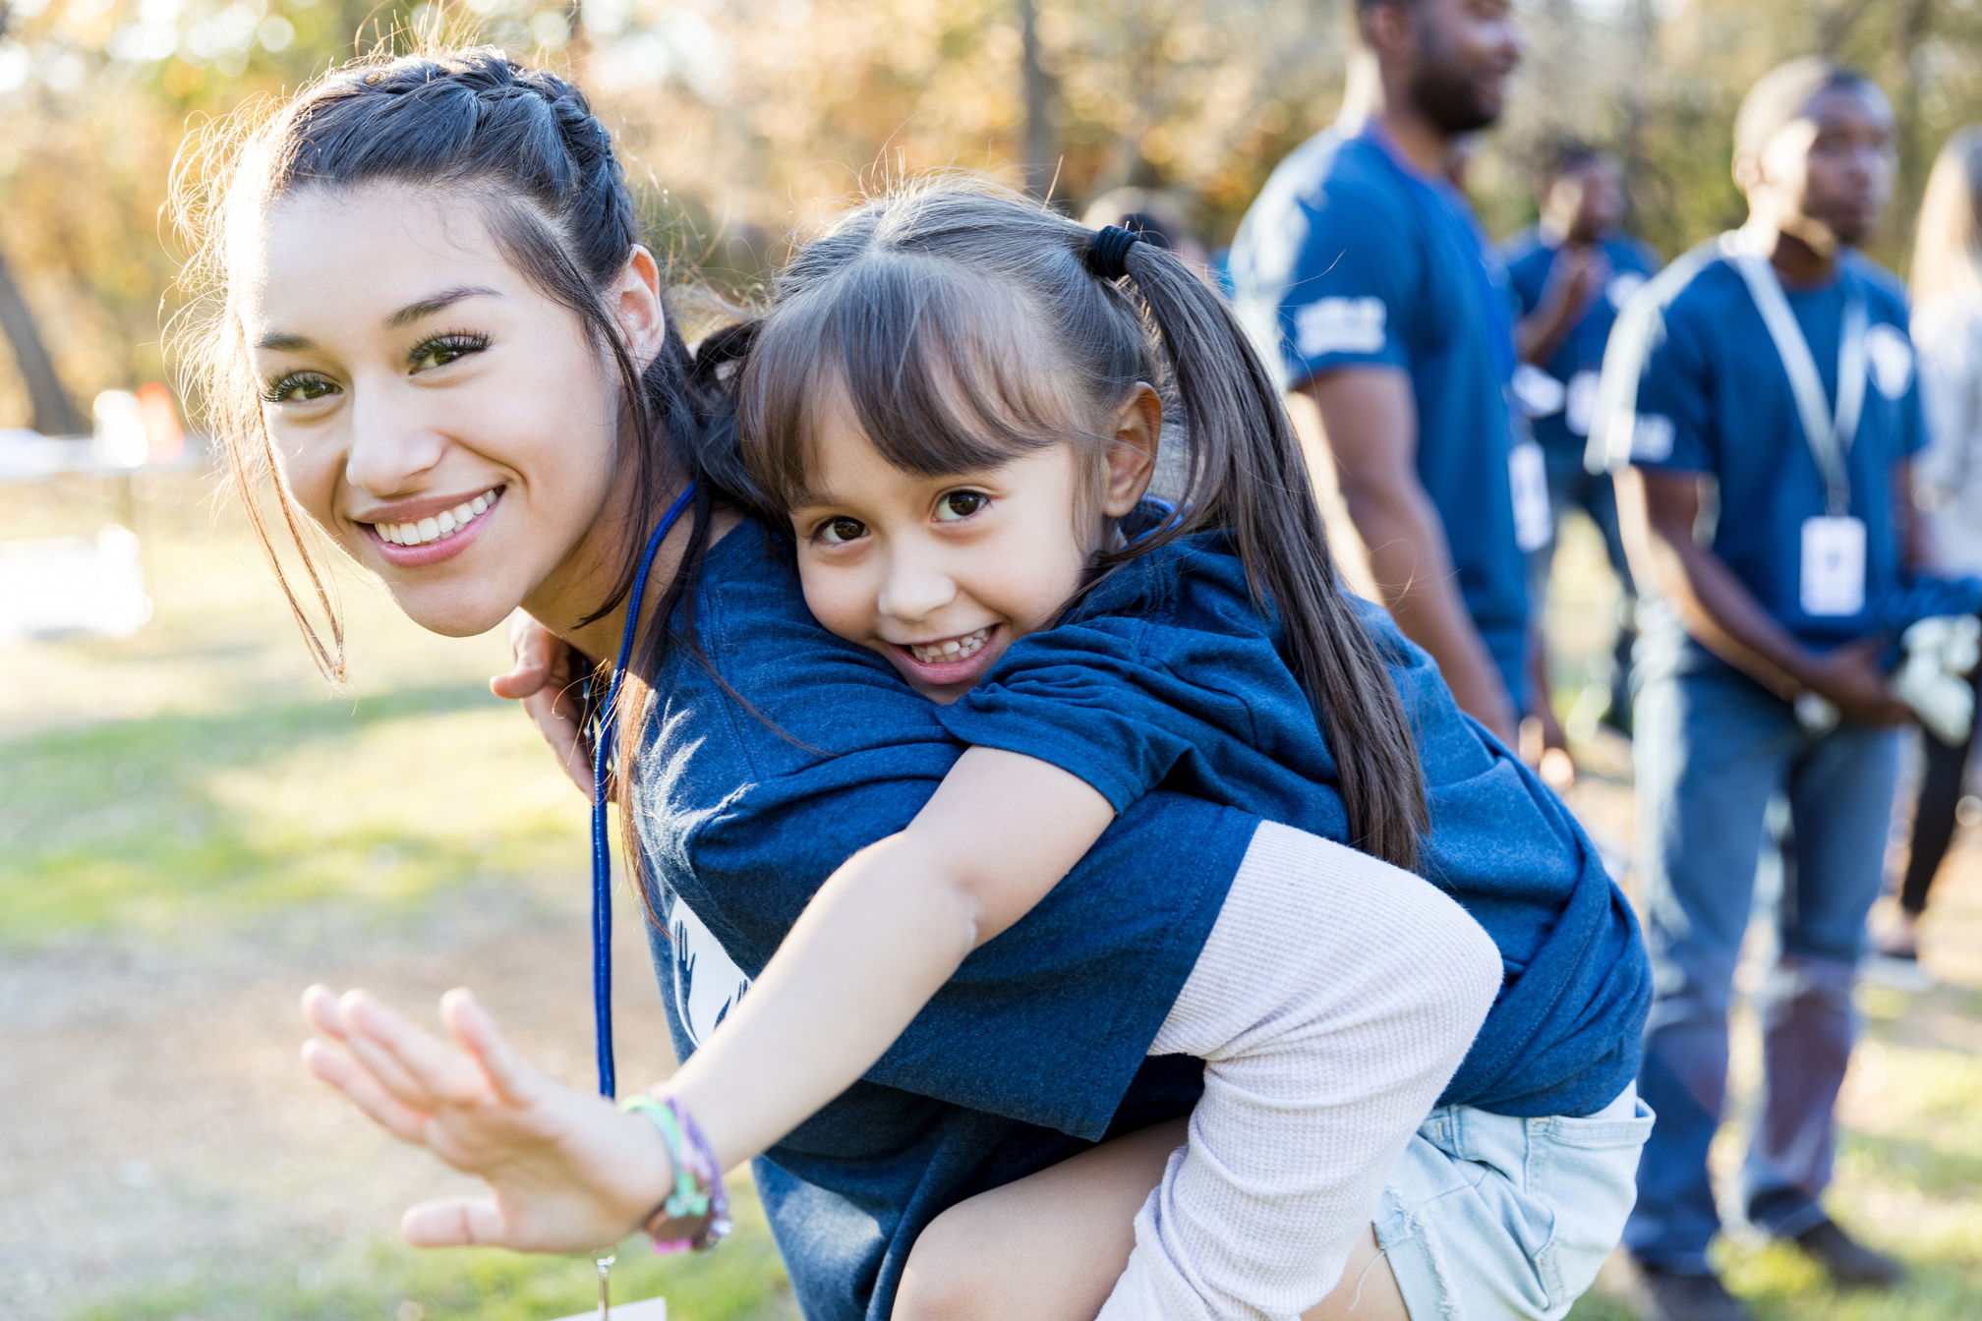
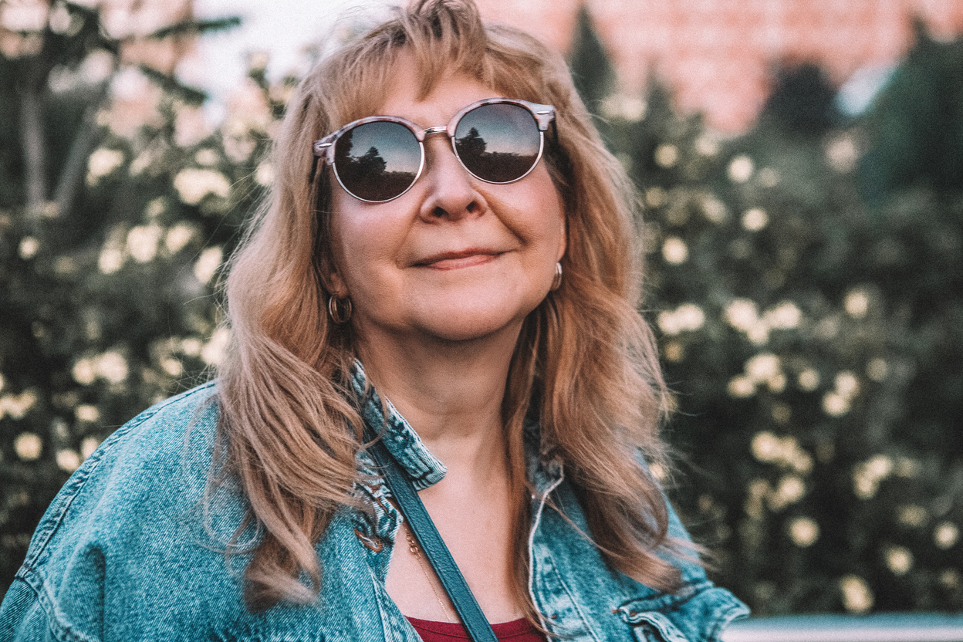
Soroptimists have BIG dreams
Notes:
Yes, just like the women and girls we serve, we Soroptimists have big dreams. We dream of a world where women have the resources and opportunities to reach their full potential. We dream of helping more girls achieve their educational goals. And we dream of doing even more…of reaching even higher.

Slide 6
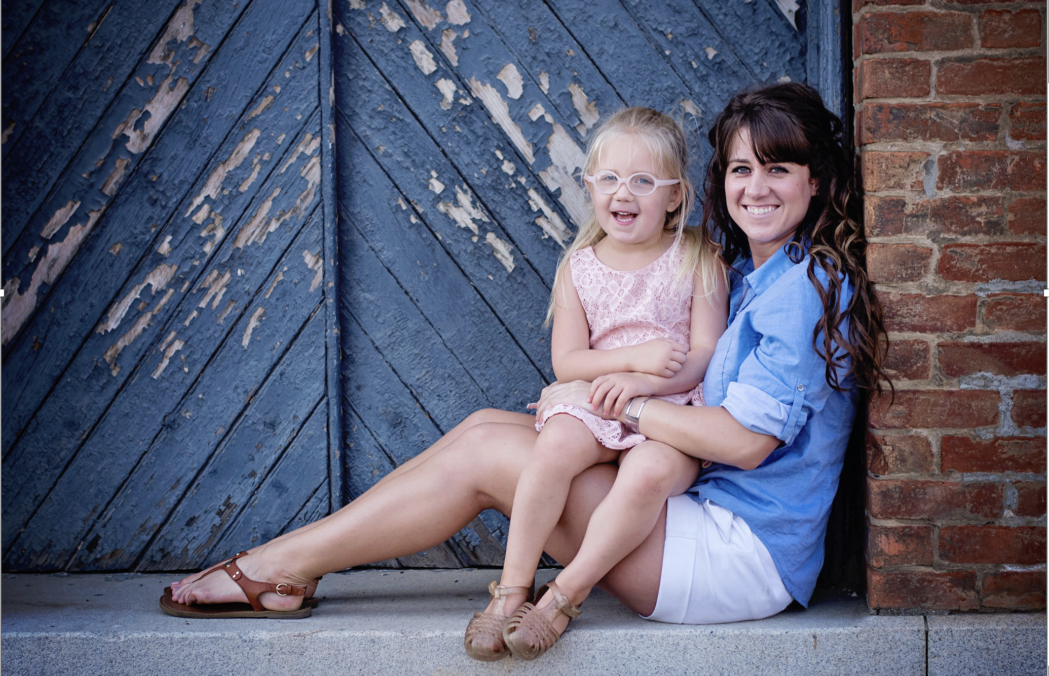
$3 million in
Live Your Dream Awards.
2024 SIA REGION CONFERENCE
Notes:
And we ARE! Just last year, we distributed nearly $3 million in Live Your Dream awards and more than $700 thousand in BGAP scholarships…helping thousands of women. But as we all know, keeping those dreams alive and achieving them takes work. Teamwork.

Slide 7
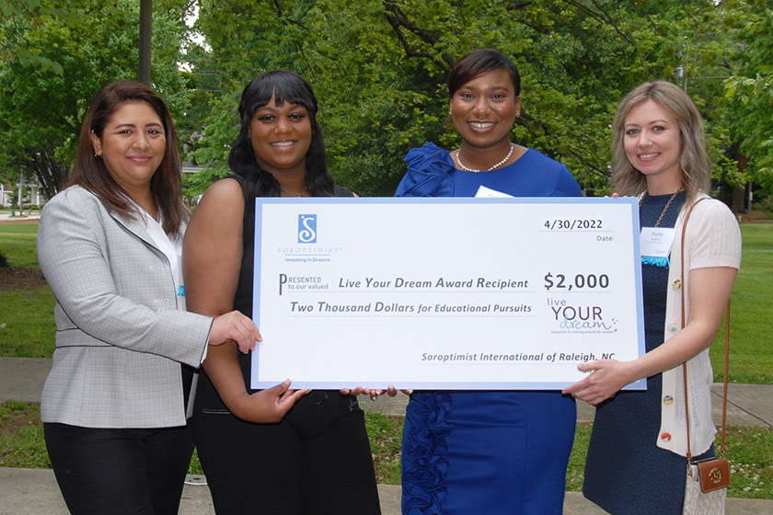


We are Soroptimists.
  A unified membership is what will help us reach higher together and drive new membership, increase brand awareness, and build program participation.
We aren’t waiting for tomorrow. We’re changing lives today.
2024 SIA REGION CONFERENCE
Notes:
The truth is, we are Soroptimists. And we are our own greatest resource when we work together. You and I both know, we aren’t waiting for tomorrow, we’re changing lives today. And it is a truly unified membership base that is the heart of our strong foundation. It’s what will help us reach higher together and drive new membership, increase brand awareness, and build program participation. It’s what will help us change the lives of even more women and girls.

Slide 8
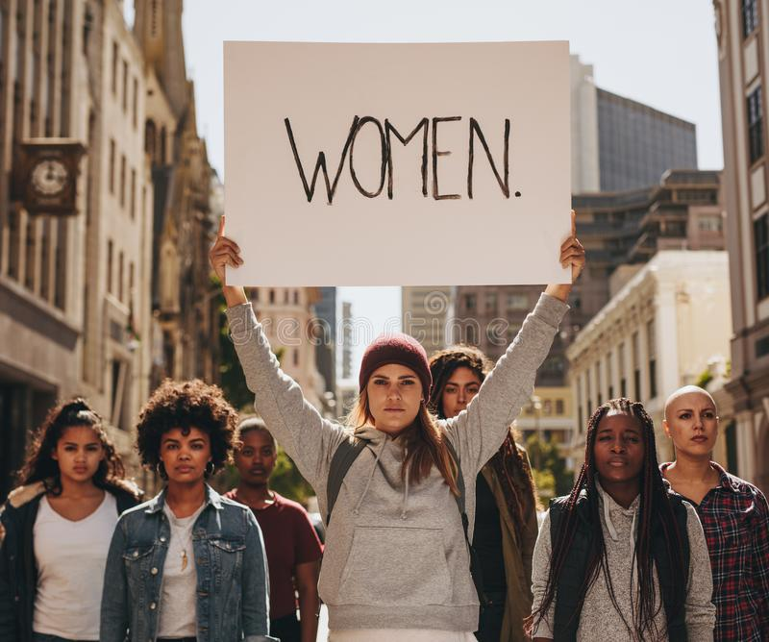
Empowered women help empower women.
2024 SIA REGION CONFERENCE
Notes:
Sure, we can launch new websites, fundraising campaigns and member recruitment programs. But if we don’t have a strong and cohesive membership to support them, those things won’t get us very far. I mention all of this with openness, honesty, and love for Soroptimist and everyone in this room. And because I truly believe in our organization. I believe in the power of women. And I believe empowered women help empower women. It’s who we are. And it’s what we do.

Slide 9
Insert a photo and example of a club in your region that has worked in unity.
2024 SIA REGION CONFERENCE
Notes:
Insert an example of a club in your region that has worked in unity.

Slide 10
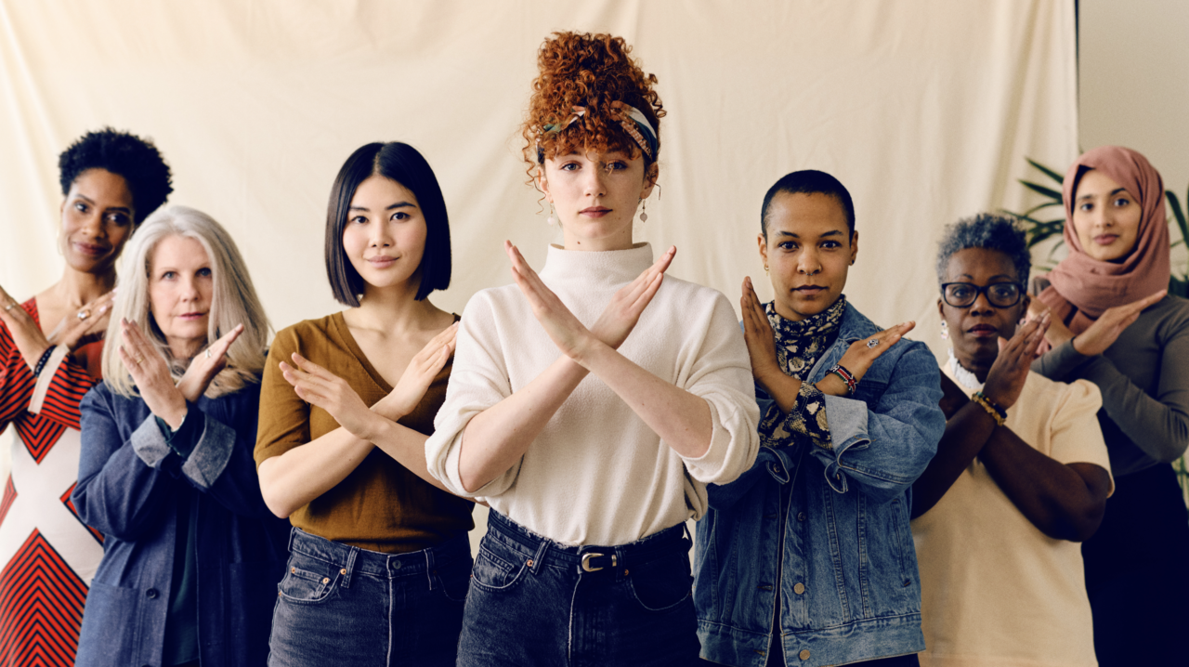


We have the power to make a difference!
Appreciate contributions
Value different perspectives
Work collaboratively
Embrace inclusivity
2024 SIA REGION CONFERENCE
Notes:
Let there be no doubt: Each and every one of us has the power to make a difference. By working more collaboratively, more inclusively, and with more kindness, we will strengthen our greatest resource…ourselves. So, let us strive to build each other up, by showing appreciation for each other’s contributions, and by valuing differing perspectives. And when we fall short of this, let’s hold one another accountable and politely straighten each other’s crowns.

Slide 11
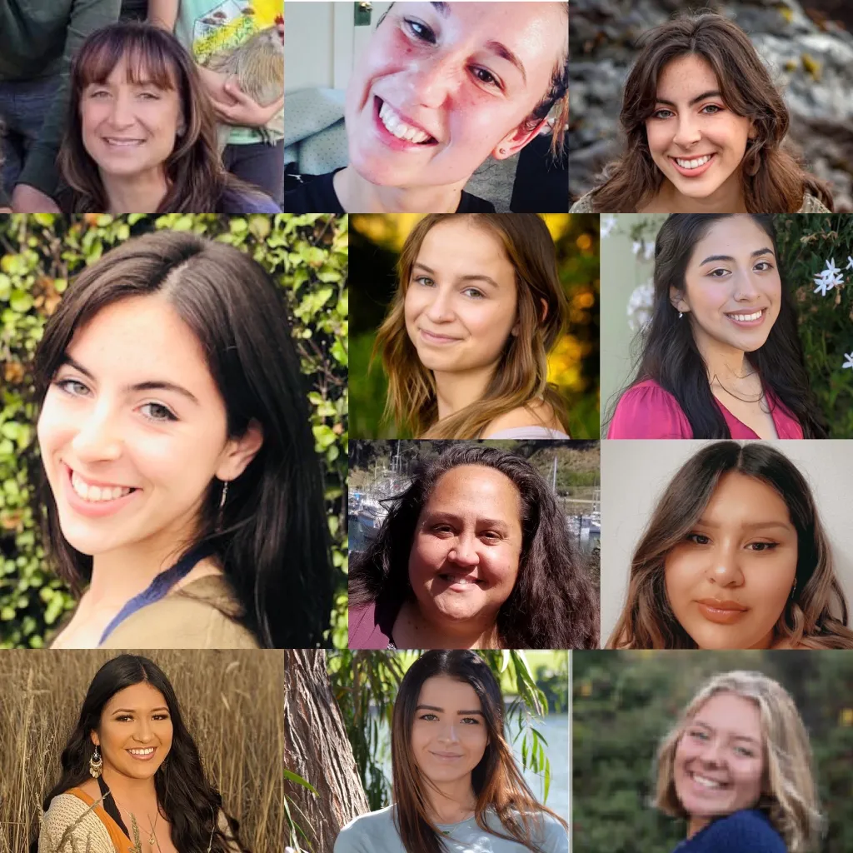
Together we will reach higher.
Unite as an organization
Grow as leaders
Fight for gender-equality
Help women & girls live their dreams
2024 SIA REGION CONFERENCE
Notes:
As I leave you today, let’s not take our eyes off our dreams and our Big Goal of impacting half a million women and girls by 2031. But let’s also reflect on how important our solid foundation is in reaching that Goal. And let’s ensure we take advantage of tools to achieve our own dreams. Together, we will reach higher. We will grow as an organization. And we will continue to work as leaders in the fight for a gender-equality world. A world where all women and girls can pursue their dreams of education. A world where women and girls can achieve economic empowerment. A world where they create a wave of change that shapes not just themselves but also their families and communities for the better.

Slide 12
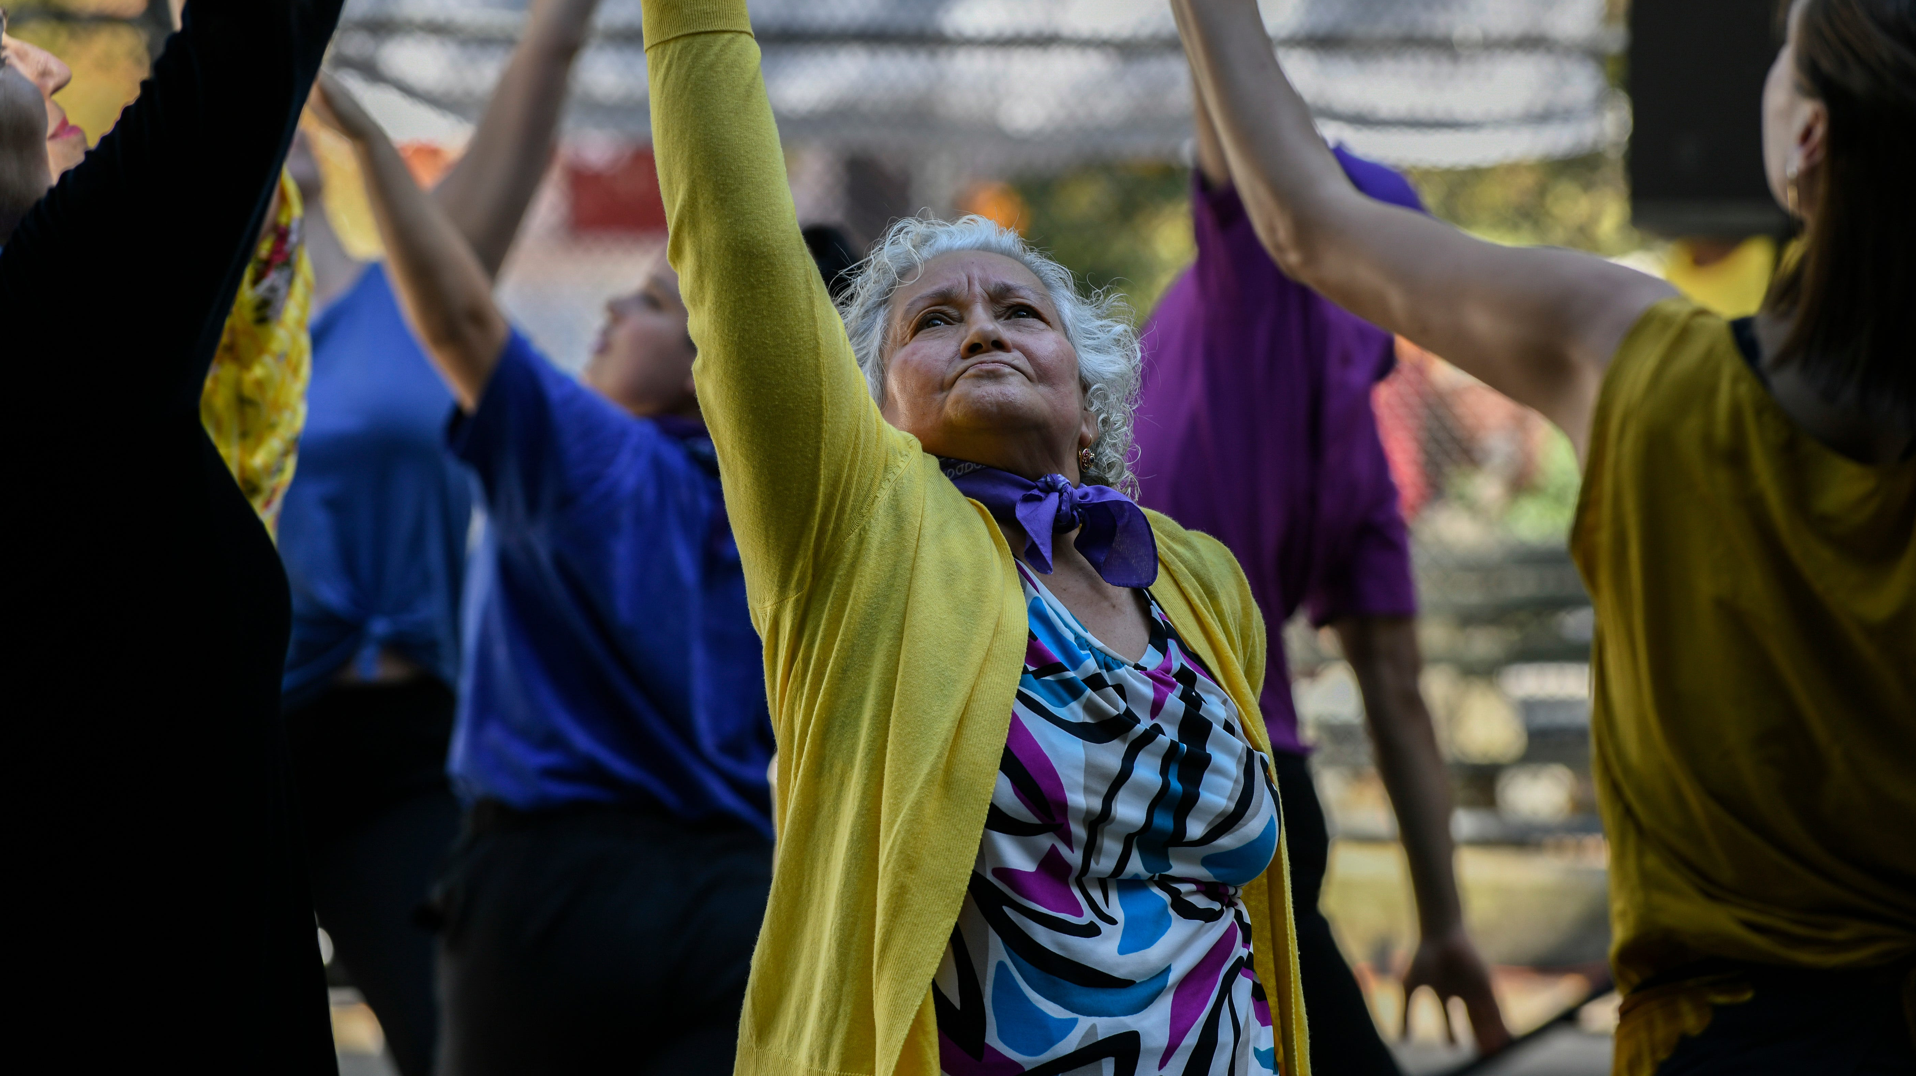
Let us dare to dream higher together.
2024 SIA REGION CONFERENCE
Notes:
With such wonderful Soroptimists here today, I have no doubt we can see past our differences and work in unity to obtain what we have in common - helping women and girls reach their full potential and live their dreams. Dearest Soroptimists: In the coming year, let’s embrace inclusivity, collaboration and unity like never before. In doing so, we will strengthen our foundation. We will take our organization to the next level. We will indeed Reach Higher – for all women and girls – together!
Thank you for all you do, and I can’t wait to see you again in Bellevue! It is going to be epic!

