Slide 1


The Role of SIA’s Board of Directors: Strategic vs. Working Boards
2024 SIA REGION CONFERENCE
2024 Region Conference
PRESENTER NAME, PRESENTER TITLE
Notes:
I am SIA Board Director {NAME}.
I am going to walk through a few topics that, on the surface, may feel a bit unrelated, but bear with me. I promise to bring them all together to give you an understanding of how key decisions are made within Soroptimist.

Slide 2


Learning Objectives
Strategic vs. Working Boards
Foundation/History
Learn how decisions are made at SIA
Role of stakeholder engagement
Questions & Answers
2024 SIA REGION CONFERENCE
Notes:
Our learning objectives for today are:
Understand the difference between Strategic versus Working boards and what type of board SIA has.
Review the history and structure of our federation.
Learn how the board makes informed decisions based on what is in the best interest of our organization as a whole. The concept of representation “OF”.
Understand how stakeholders like yourselves are engaged and play a key role in SIA’s decision-making process.
After that, I will open the floor for questions and hopefully answer those questions.

Slide 3



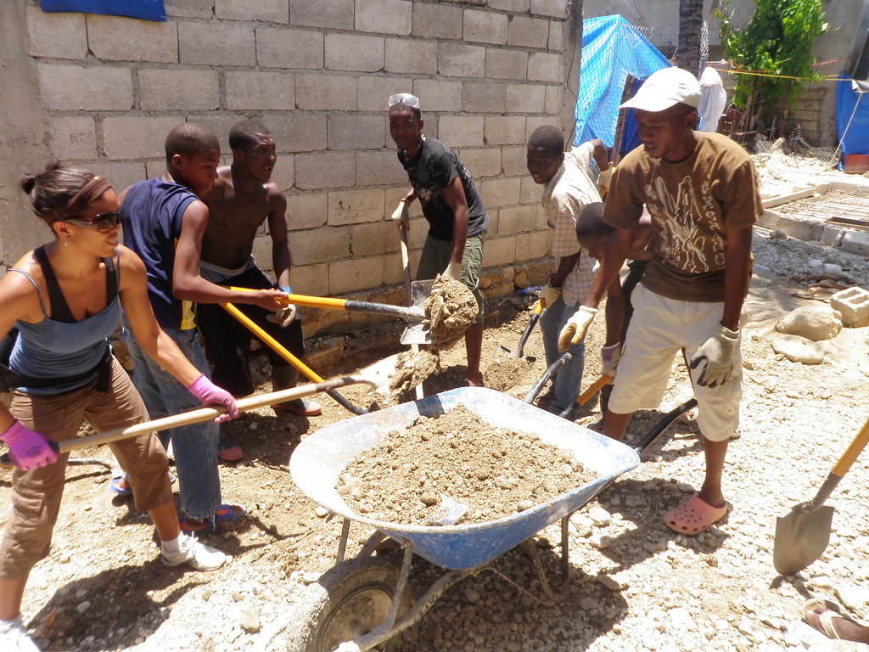

SI Europe
(43 countries, 33k members)
SI Great Britian and Ireland
(18 countries, 6k members)
SI South East Asia Pacific
(13 countries, 2,287 members)
SI Africa
(22 countries, 1,519 members)
*Note: SI’s official logo has changed
This Photo by Unknown Author is licensed under CC BY
2024 SIA REGION CONFERENCE
Notes:
Let’s start with defining the difference between a working board and a strategic board.

Slide 4
Working Boards:
A working board is a group of directors actively participating in the organization's daily activities. It is a governing board with additional responsibilities: Directors perform their strategic and fiduciary duties as well as participate in the organization's day-to-day functions.
Examples of Working Boards:
Club Board
Region Board
Soroptimist International Board
This Photo by Unknown Author is licensed under CC BY
2024 SIA REGION CONFERENCE
Notes:
Working boards are typically a group of directors actively participating in the organization's daily activities. It is a governing board with additional responsibilities: Directors perform their strategic and fiduciary duties and participate in the organization's day-to-day functions.
You may be more familiar with a working board structure, as it is typically how clubs and regions operate. The club leadership is responsible for setting the plan for the club year and operationalizing that plan.

Slide 5

Strategic Boards:
A strategic board is responsible for setting the organization’s strategic direction and ensuring it is aligned with its mission and values. The board also monitors the implementation of the strategic plan and oversees the use and development of resources.
Examples of Working Boards:
SIA’s Federation Board of Directors
2024 SIA REGION CONFERENCE
Notes:
Strategic Boards, also often called governing boards, function a bit differently. These boards are responsible for setting the organization’s strategic direction and ensuring it is aligned with its mission and values. The board also monitors the implementation of the strategic plan and oversees the use and development of resources.
As in the case of SIA and many US corporations, they usually have a paid professional staff to operationalize or implement the strategic plan as established by this board.

Slide 6
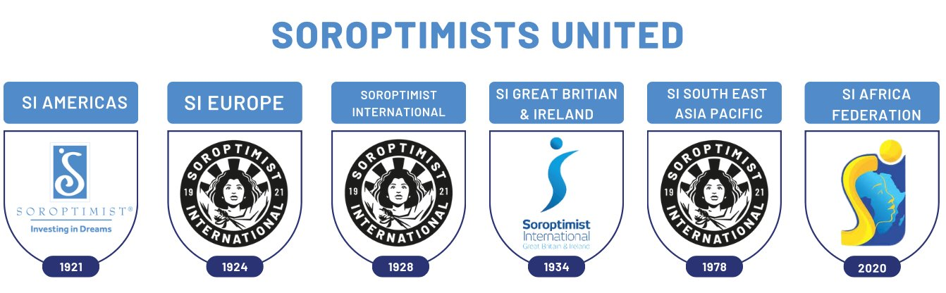
Notes:
Now that we have established the difference between a working and strategic board. Let's talk a little bit about the foundation of SIA and how this structure came to be. A good first step to understanding where you are is understanding how you got there.
So, let’s start from the beginning.
In 1921 the beginnings of Soroptimist International of the Americas was formed. As the diagram shows, shortly after Soroptimist International of Europe was formed, Soroptimist International was formed as a linkage between the two initial federations. To follow were SI Great Britain and Ireland (who hosted the SI convention last year in Dublin), SI South East Asia Pacific (formally SI South West Pacific), and the newest Federation, SI Africa—totaling what we now know as the five federations that make up SI.
SI initially followed what would be considered a top-down leadership approach, where SI set the direction and took on a more parental role over the federations. Over time, the structure gradually shifted to a bottom-up design. One in which each of the various federations, including SIA, control SI by serving as its leadership via a working board made up of members from representatives from the multiple federations.

Slide 7

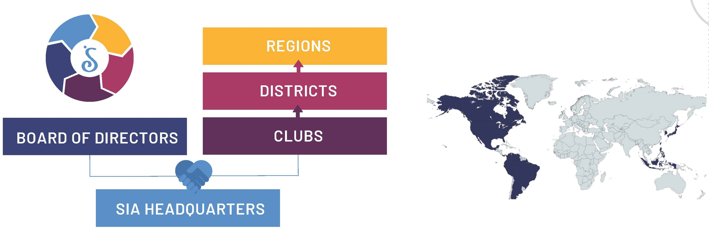
Soroptimist International of the Americas, Inc.
2024 SIA REGION CONFERENCE
Notes:
SIA’s board was initially comprised of leadership from each region and was rather large, with board members actively working on the organization’s daily operations. Over the last 25+ years, SIA’s board began to lean more toward a strategic board consisting of representatives from various Electoral areas. This reduced the size of the board to 14 members.
With the reduction in size and hiring of additional professional staff, including an Executive Director/CEO, the board now functions as a strategic board. It relies on staff, at the direction of the ED/CEO to manage daily operations.

Slide 8

SIA Board of Directors
Elected from membership
Representative “OF” not FOR
2024 SIA REGION CONFERENCE
Notes:
Now, let’s talk about the SIA board of directors and how they operate strategically- with member representation.
You already know that members of our various Electoral Areas, elect our board. However, you may not be aware that they are elected to represent the entire membership body. That is the difference between being a representation “OF” versus “FOR.”
When you are a representative “FOR” – you represent just the members of your own club, region, and/or electoral area. When you are a representative “OF”- you represent all the members of SIA, all 25000+. This is a very important concept and one that the board uses when making decisions.

Slide 9

Roles and Responsibilities
Establish identity
Ensure resources
Provide oversight
2024 SIA REGION CONFERENCE
Notes:
And as a strategic board, the primary roles and responsibilities of a director can fall under three categories:
1. Establish the organization's identity – in short, the board establishes who we are and what we do, which is more commonly referred to as our mission and vision.
2. They are also tasked with ensuring we have appropriate or necessary resources to achieve that mission (this is done via budget monitoring and other approval of the use of the organization's resources).
3. Lastly, they provide oversight and monitoring as we move toward that mission.

Slide 10


SIA Board of Directors
Representative “OF”
Set Direction
Vote
Monitor
2024 SIA REGION CONFERENCE
Notes:
As the board of directors – and representatives “OF” the membership body, they are the direction setters.
In other words, when you say or hear other members say things like “SIA told us to,” or “SIA has changed the way we do (this thing or that)” or “SIA’s no longer focuses on {TAILOR TO A LEGACY PROGRAM IN YOUR AREA} but instead on Education as a means toward economic empowerment,” what they are actually saying is the SIA Board of Directors has done this thing or that thing. This is a concept that has been difficult for many to grasp.
When members say SIA, they often refer to Headquarters or the Headquarters staff. Many are confused as to how decisions are made.
Here is an example:
Whenever there is a need to increase dues, members usually say SIA is increasing dues. They are unfamiliar with the process and often believe this decision comes from headquarters. When, in fact, the board of directors makes the decision via a vote as representatives of the entire organization. Let's walk through this process together.

Slide 11
SIA Annual Dues Increase
Decision making process
SIA Sets Strategic Direction/Objectives
Tactical Plan and Budget to achieve set objectives
SIA Board of Directors Approve Plan and Budget
Communication of Dues increase
Monitoring
2024 SIA REGION CONFERENCE
Notes:
Annually, the SIA Board of Directors meet to review the current strategic plan. At that meeting, they work collectively to establish and/or re-establish the strategic plan and corresponding goals and objectives for the following fiscal year.
The board sets the strategic plan as representative of the entire membership body via a majority vote. After that, SIA Headquarters staff – at the direction of the Executive Director work to develop tactics and a corresponding budget necessary to facilitate those tactics and work towards the achievement of the objectives set by the board. The Board then reviews the tactics and approves the budget. Once the budget is approved – which may include or require an annual dues increase – Headquarters staff communicates the increase to members via various avenues and media.
During the year, the board receives budget and other monitoring reports that allow them to monitor the business operation and ensure it is in accordance with the strategic direction they’ve set.

Slide 12
Leadership Round Table
Decision making process
Research and Development
SIA Board of Directors Approval
Implementation
Member/Leadership Engagement
Monitoring and Update
2024 SIA REGION CONFERENCE
Notes:
Let’s try another one:
You all may be familiar with the training opportunities such as: (List training opportunities)
These opportunities are a result of member and leadership engagement via surveys and other direct engagement efforts. Members express an ongoing need or interest in a particular topic. That information is shared with headquarters staff.
Let's take the development of the leadership round table as a prime example of such efforts. To most, it may seem like the Leadership Round Table just appeared. However, it is a result of many years of research and, most importantly, member and leader engagement. We found that there was a need for leadership training over and above what may have been provided at the club and region levels. Headquarters staff then present the concept to the Board of directors, who then approve the program’s use of resources and structure. It is then implemented and operationalized by staff. Via monitoring reports and various updates, the board is made aware of the progress and successes related to the program.
{Maybe add an additional example or enlist an example from the audience}

Slide 13


Member Engagement
Vote
Club Delegates
Surveys
Reach out to HQ
2024 SIA REGION CONFERENCE
Notes:
I hope one of the major points you take away from those examples is the importance of your voice as a member. There are several ways you can effectively share your voice. The first and most important one is voting. As in any democratic system, if you don’t vote, your voice won’t count. There are multiple opportunities to vote – for your club leadership, region leadership, and board leadership. Unfortunately, the current percentage of members who vote in elections is very low. Another opportunity to vote is at the Convention during the general meeting via your club delegates. Typically, less than 25% of our club delegates attend the convention.
The other way to have your voice count is via surveys. Headquarters issues multiple surveys annually. They are designed to collect data to inform board decisions. Please take a moment to respond to them when they come your way.
And lastly, reach out to SIA Headquarters. They would love to hear from you: the good and the bad. If you feel like we are doing something amazing and you really like the direction, let them know, and if you have suggestions on how we could improve, they would love to hear that as well. Just remember that we are an organization of over 25 thousand members, all with varying thoughts, opinions, and viewpoints. There are many things to consider when you are a representative “OF.”

Slide 14

Key Take Aways
SIA Strategic Board
Representatives “OF”
SIAHQ Operationalizes Decisions
Importance of member engagement
2024 SIA REGION CONFERENCE
Notes:
As I conclude and before I take questions, I want to make sure we review the key takeaways from this workshop session:
1. SIA has a strategic board that is responsible for setting the direction of the organization and monitoring its progress and resources
2. SIA’s board of directors are representatives “OF” the entire membership and follow that thought process when making decisions. Their goal is to make decisions for the good of the organization as a whole, all of its members, and the women and girls we serve.
3. SIA Headquarters staff is there to implement those decisions and, via the direction of the ED/CEO, is responsible for the organization’s daily operations.
4. I can not stress enough the importance of member engagement and making your voice heard.
I will now take questions.

Slide 15



2024 SIA REGION CONFERENCE

